Slide 1
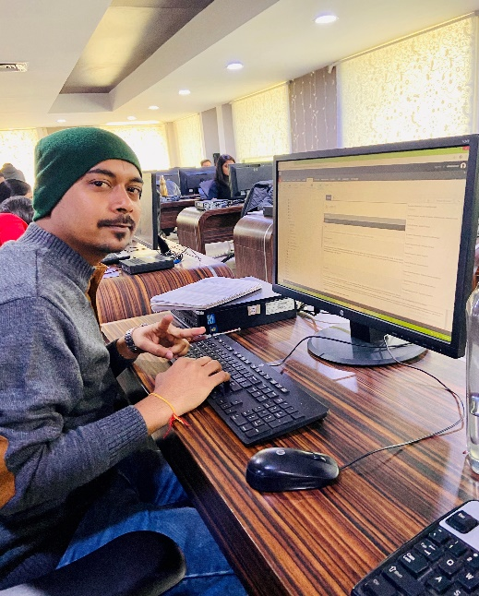
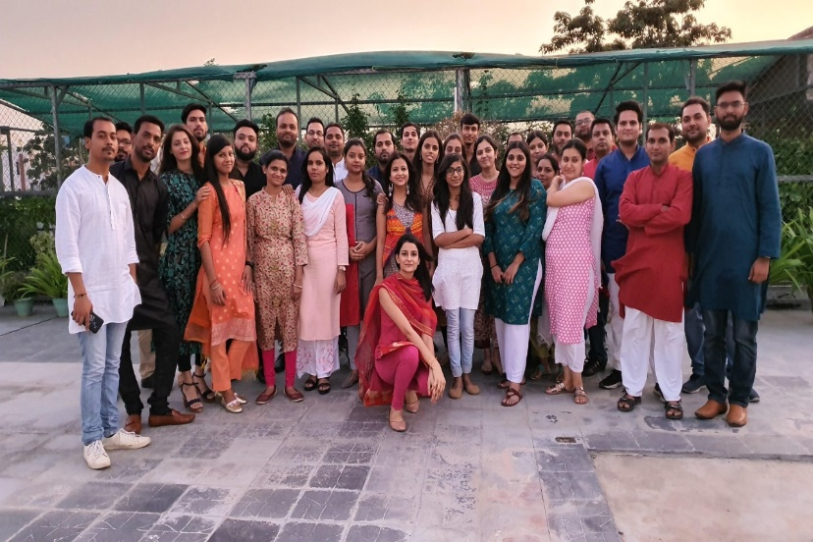
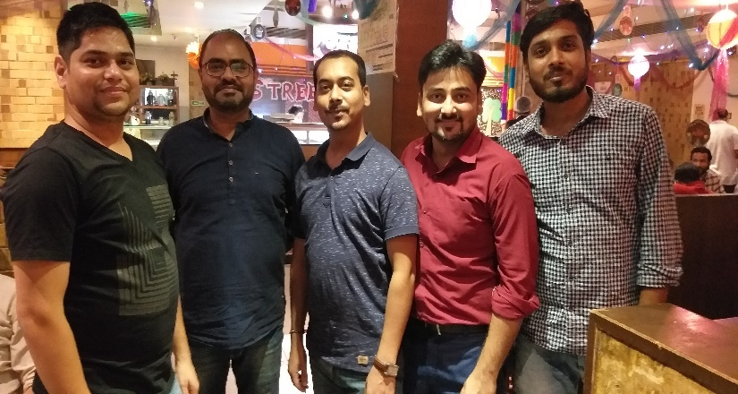
YEAR 2020
YEAR 2019 (OMNIE FAMILY)
Omnie
SINCE JUNE 2019
As a fresher, Omnie has been a guiding star in my professional career. I learned a lot from my seniors who help me grow continuously. Omnie provides good environment to work in and different technologies to explore. Apart from that, I made a lot of friends that I can count on professionally and emotionally. Overall, it has been quite a journey and I wish the best for Omnie going forward.
YEAR 2019

