Slide 1
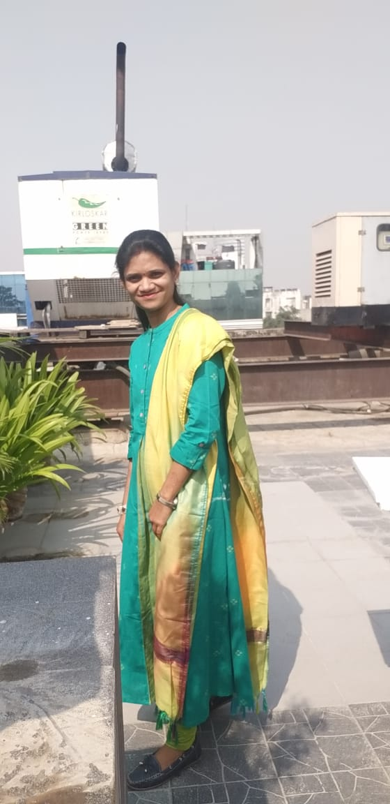
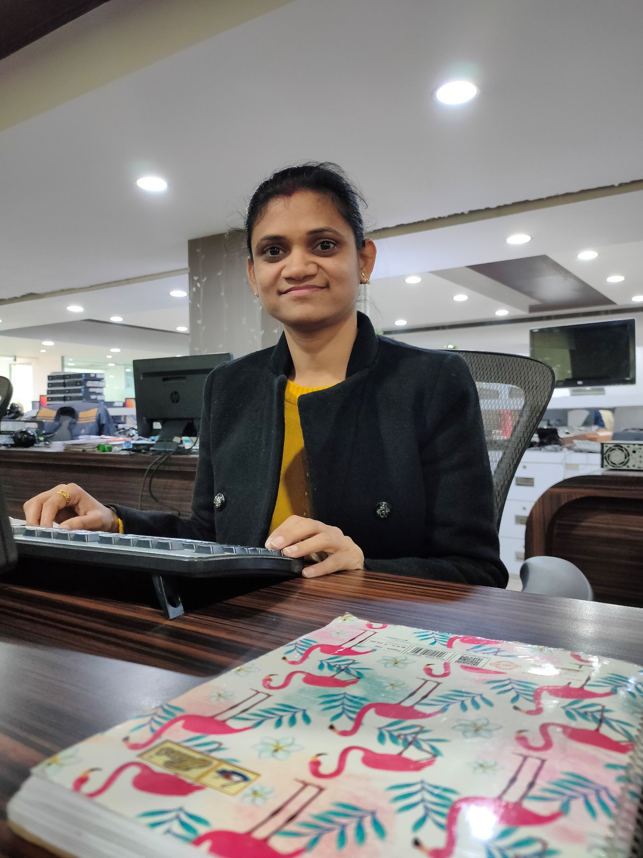
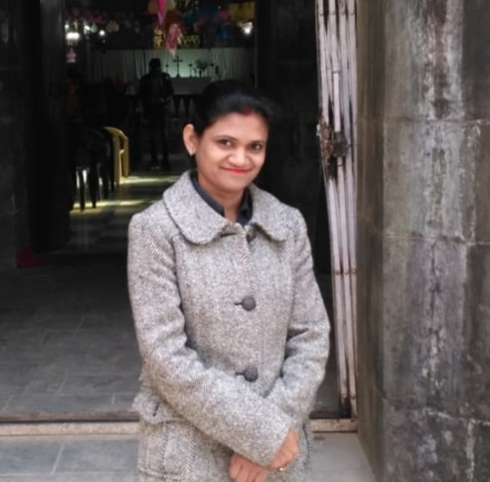
YEAR 2019 (Any special picture of you – at your workplace)
YEAR 2019 (year of your joining)
My Experience with Omnie…
SINCE June 2019 (Since your Year of joining)
My experience with Omnie is quite good so far, I learnt, in great details in terms of positivity, technology and confidence.
YEAR 2020

