Slide 1
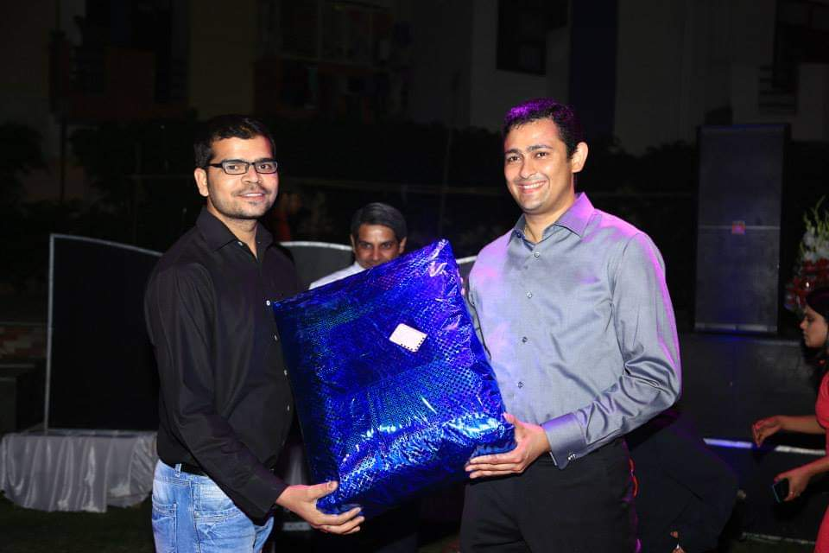
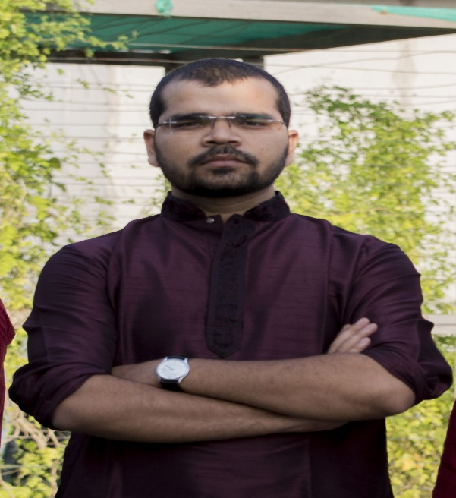
YEAR 2012 (year of your joining)
YEAR 2015 (Any special picture of you – at your workplace)
My Experience with Omnie…
YEAR 2020
SINCE June 2012 (Since your Year of joining)
Omnie is good place to learn and grow, and its organic meal is best to be healthy.

