Slide 1
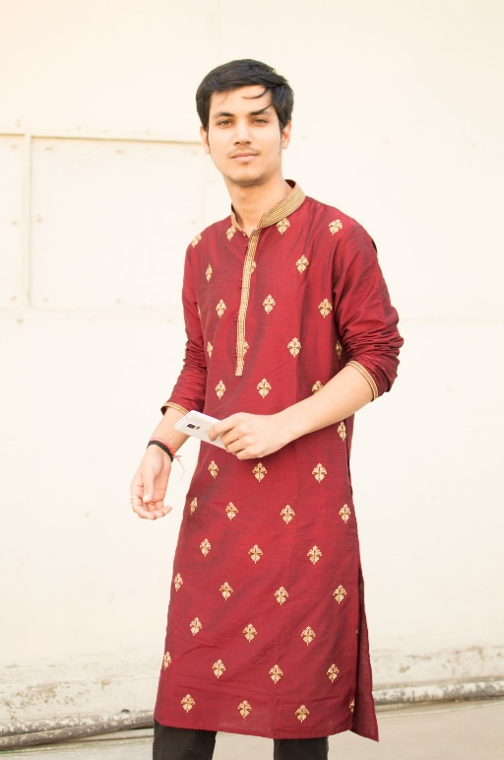
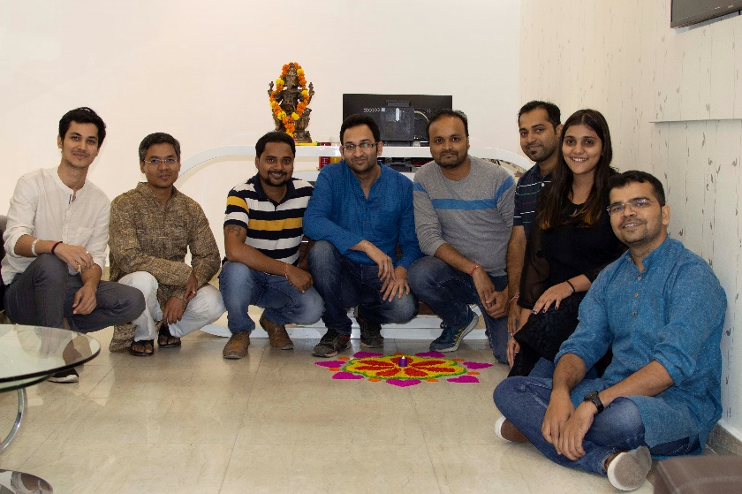
YEAR 2019 (year of your joining)
YEAR 2019 (Any special picture of you – at your workplace)
My Experience with Omnie…
SINCE JUNE 2019
Learned a lot, made a lot of friends, experienced one good earthquake, enjoyed (kind of) healthy food, became more responsible and if I leave tomorrow, I’ll be taking a lot of memories and knowledge with me. I don’t focus on the negatives. So, thank you for everything Omnie.
YEAR 2020

