Slide 1
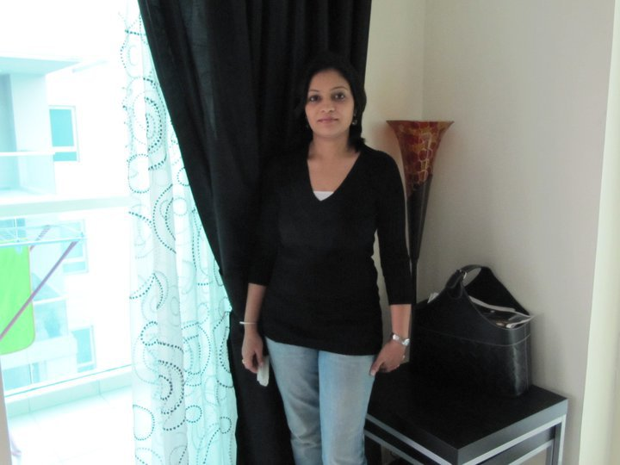
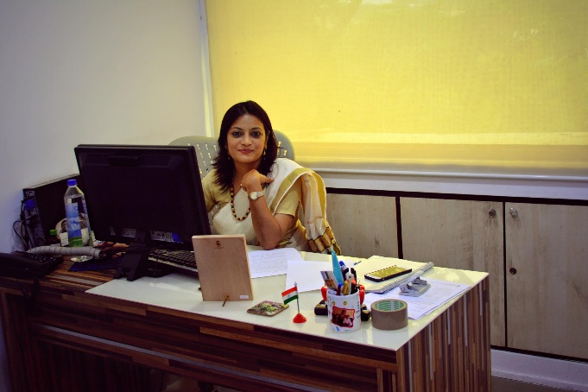
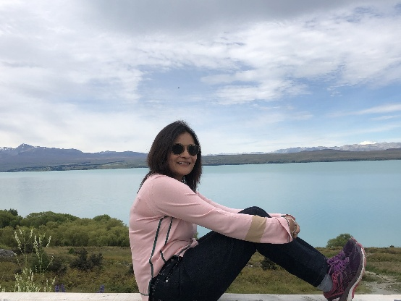
YEAR 2008
#myspace#omnie
My Experience with Omnie…
SINCE 2008
“Work gives meaning and purpose and life is empty without it”. Thanks for the beautiful years of valuable experience. Wish Omnie many more glorious years of Success…
YEAR 2020

