Slide 1
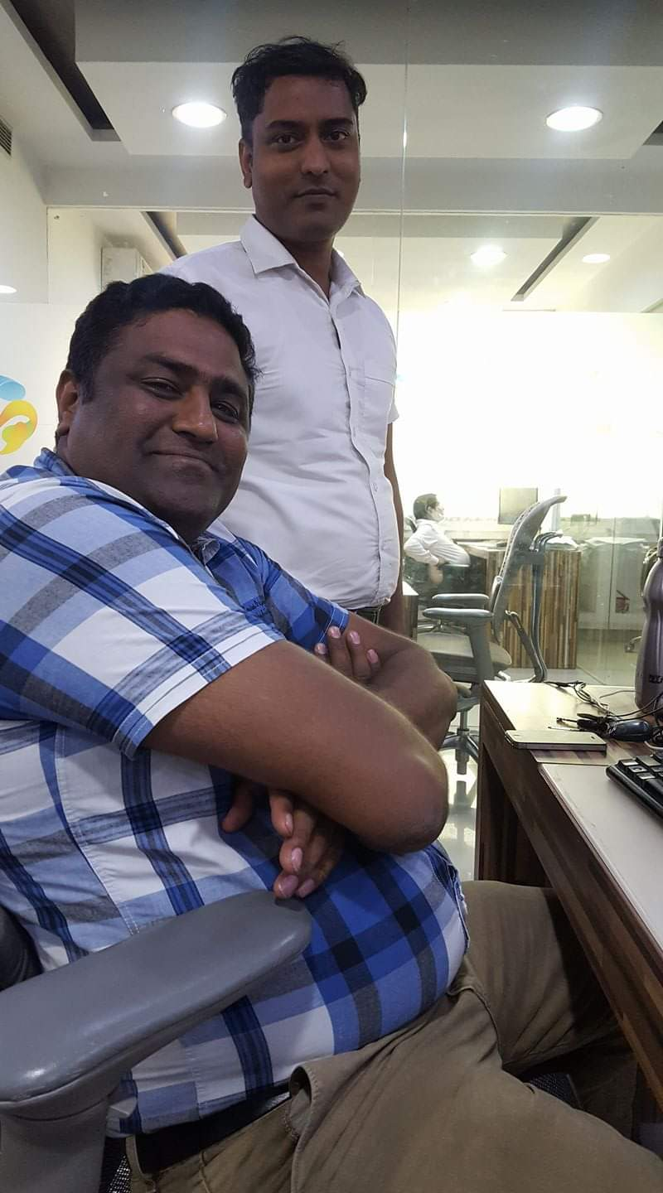
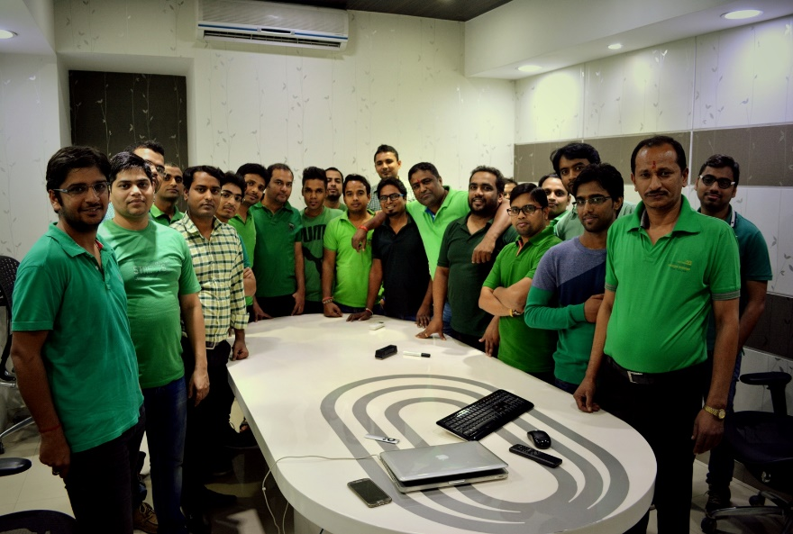
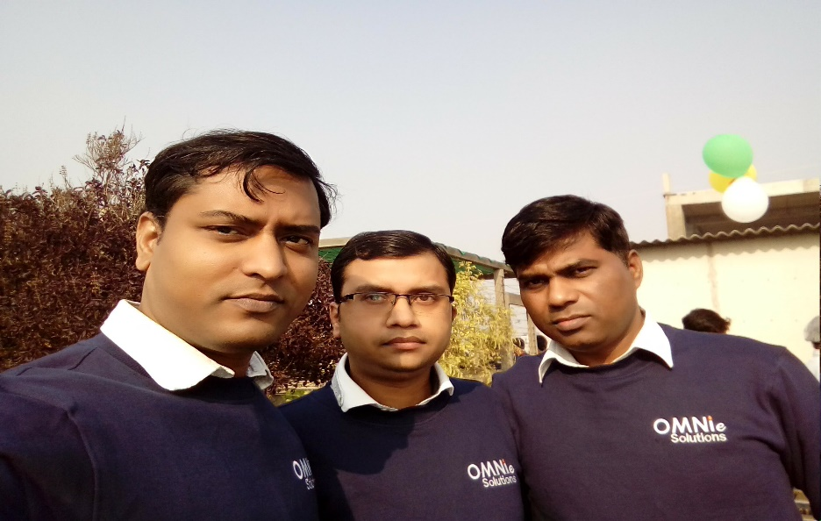
YEAR 2011
YEAR 2015
My Experience with Omnie…
SINCE JAN 2011
I am working with Omnie full-time more than 8 years. Pleasant working environment and very helpful seniors. Omnie provide the good exposure to learn new technology and all benefits including Flexible timing, bonus, timely salary and leave facility. Company provide the great exposure for fresher’s at beginning stage ,seniors are very supportive and helpful.
YEAR 2020

