Slide 1
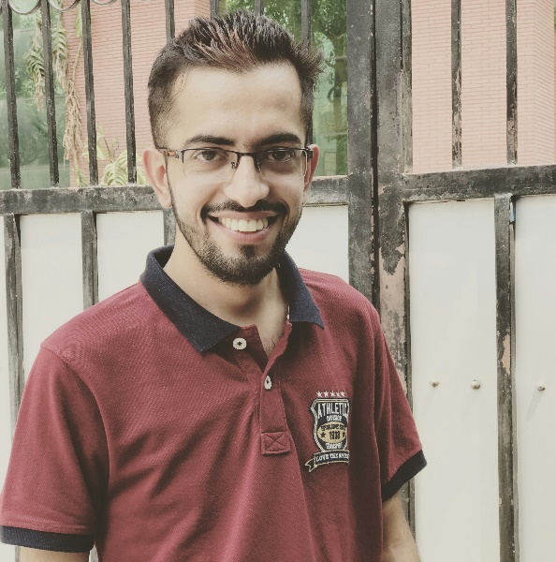
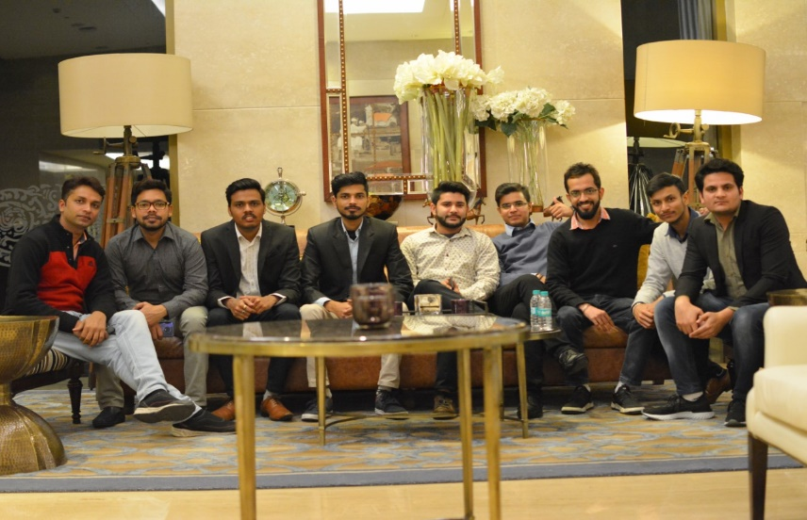
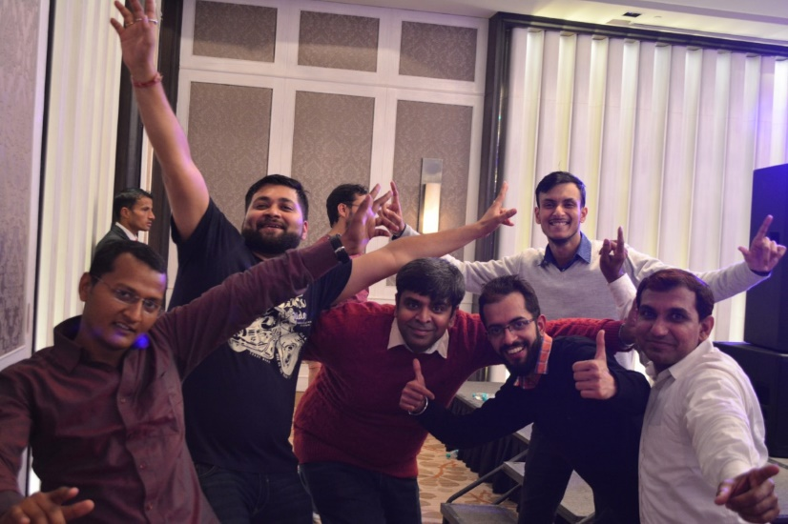
YEAR 2017 (year of your joining)
YEAR 2018 (Any special picture of you – at your workplace)
My Experience with Omnie…
SINCE JAN 2017 (Since your Year of joining)
From last 3 years, I am part of Omnie family, where I get good work environment, seniors and friends. In this family, no one restricted to enhance their knowledge and every time you got the support of seniors and team members in every aspect of your life.
YEAR 2019

