Slide 1
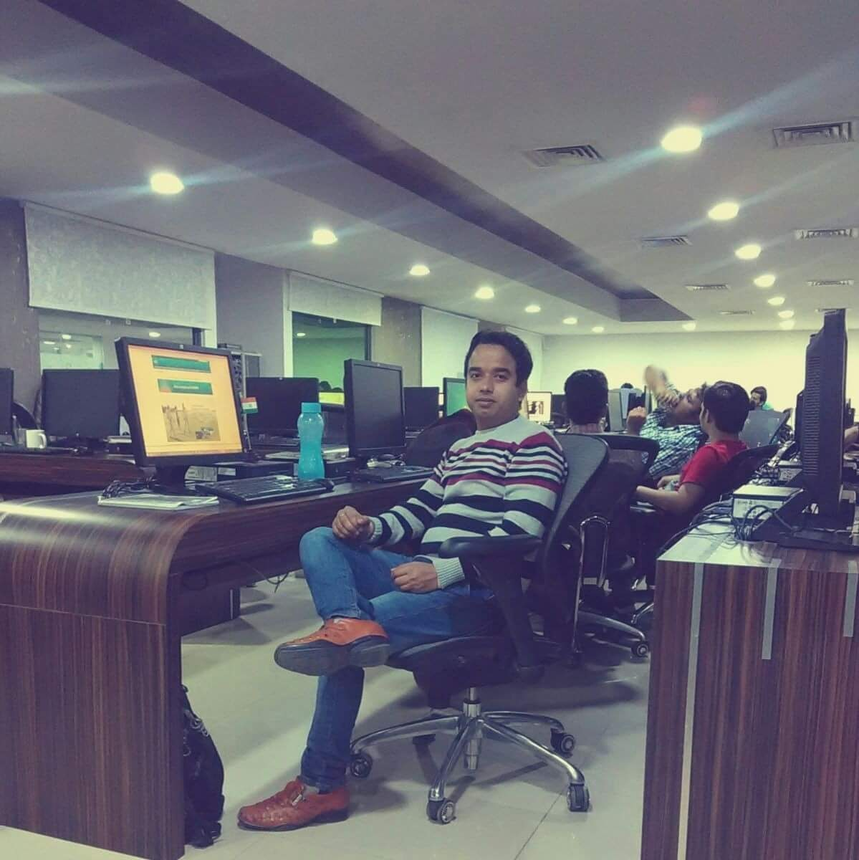
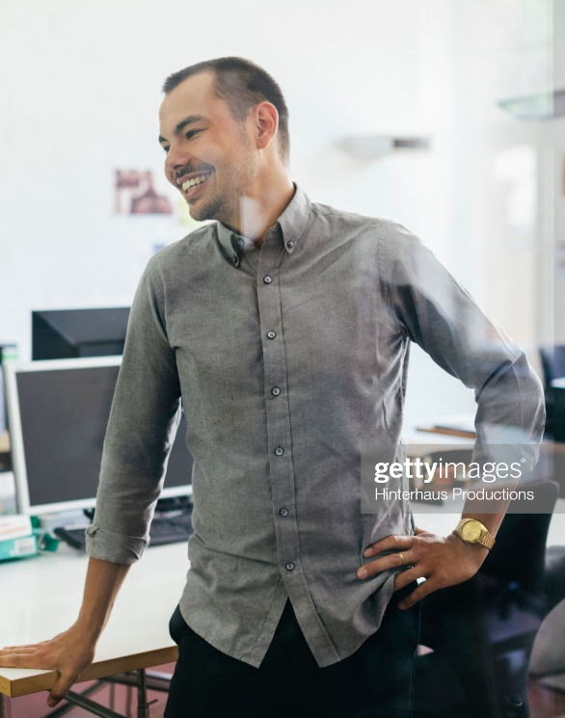
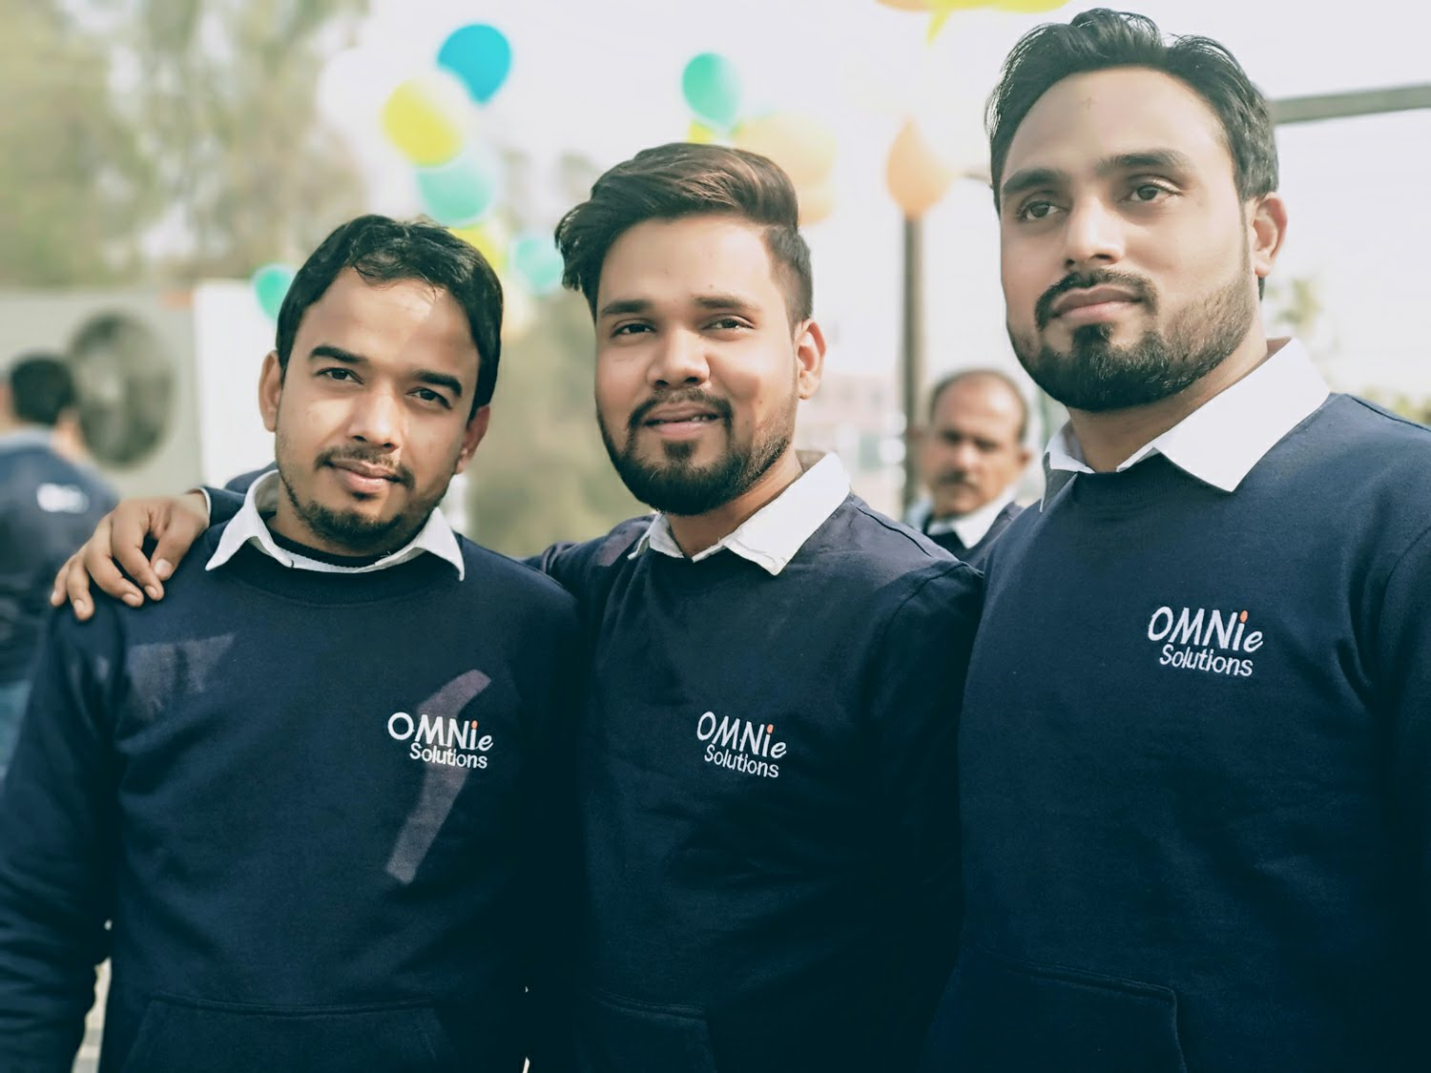
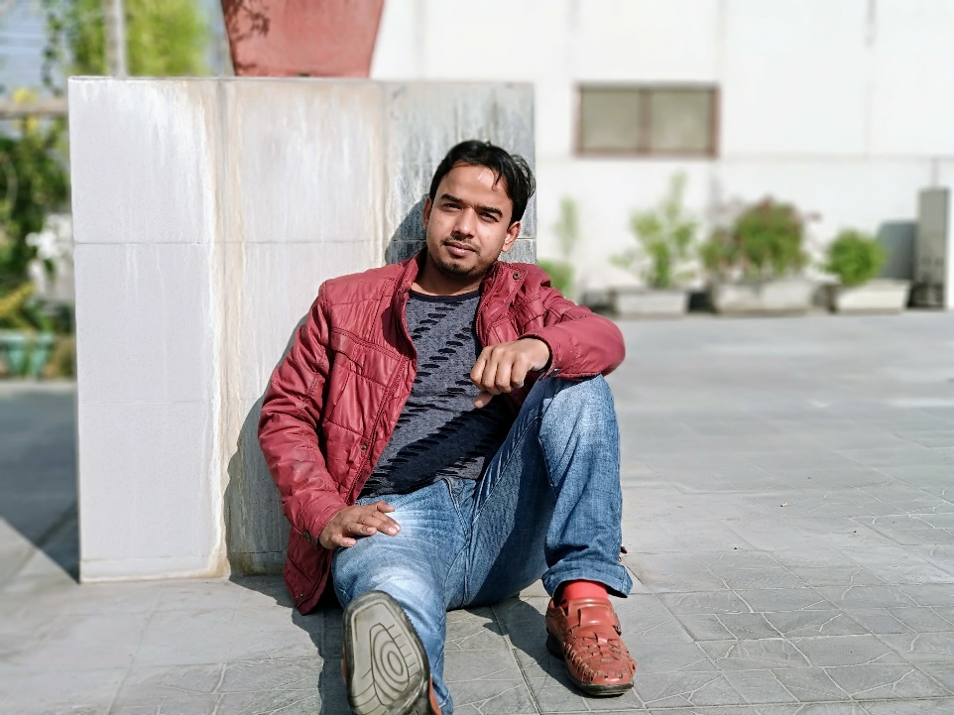
My Experience with Omnie…
SINCE 9th May (2011)
I AM VERY HAPPY TO WORK IN OMINE, I have no words to explain my attachment, Omnie permanently fixed in my heart. My team is very supporting for any kind of work.
Thanks Omnie:-0

