Slide 1
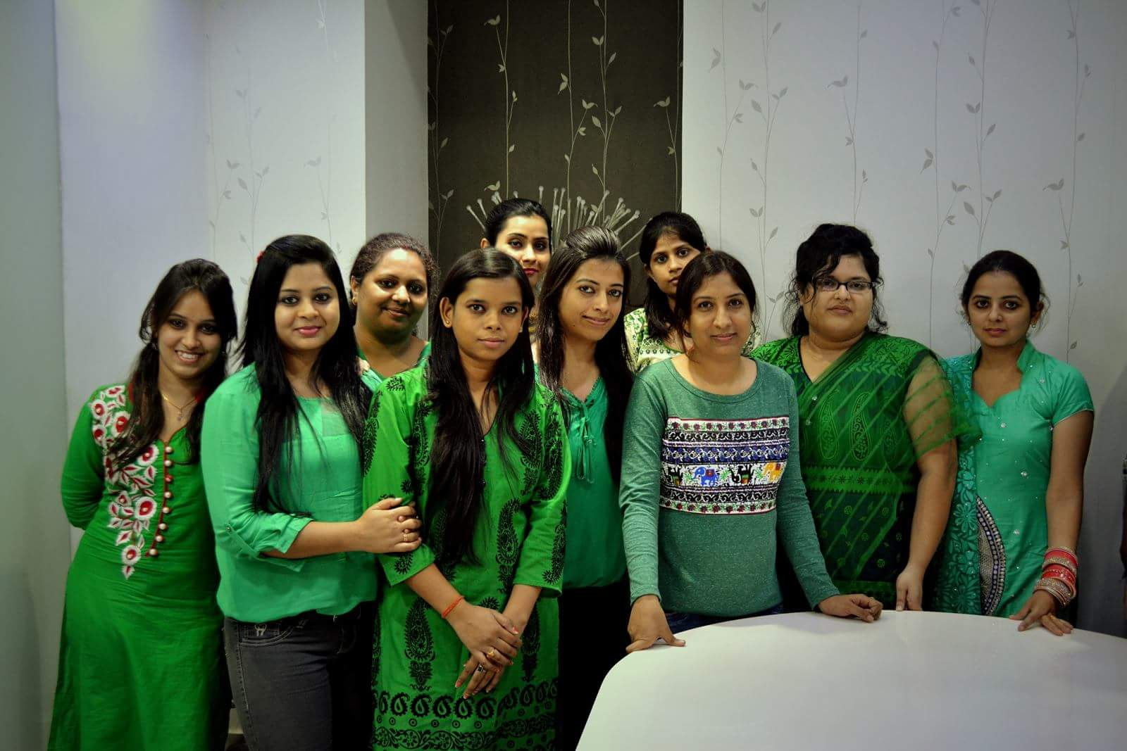
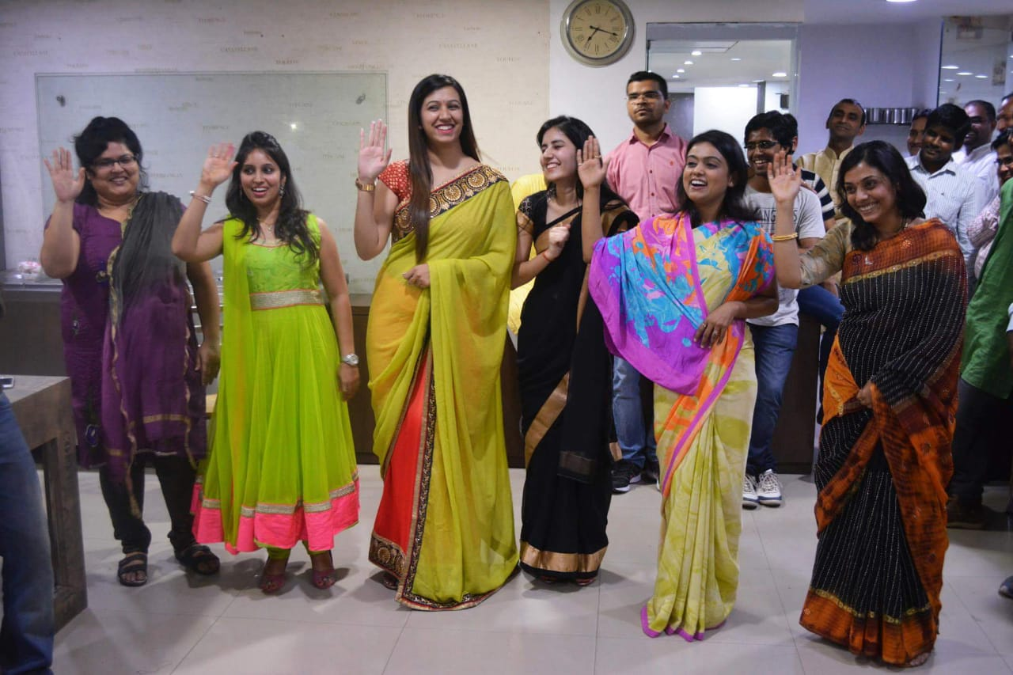
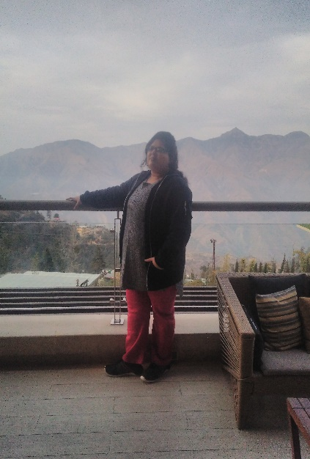
YEAR 2015 (year of your joining)
YEAR 2015 (Any special picture of you – at your workplace)
My Experience with Omnie…
SINCE JUNE 2015 (Since your Year of joining)
It has been a memorable journey, with all type of experiences & some unforgettable moments. I have learnt new things, both professionally & personally. I made some good friends. You should always try to make yourself a better person, than yourself, never compare yourself with some other. (put your feelings towards Omnie in words )
YEAR 2020

