Slide 1
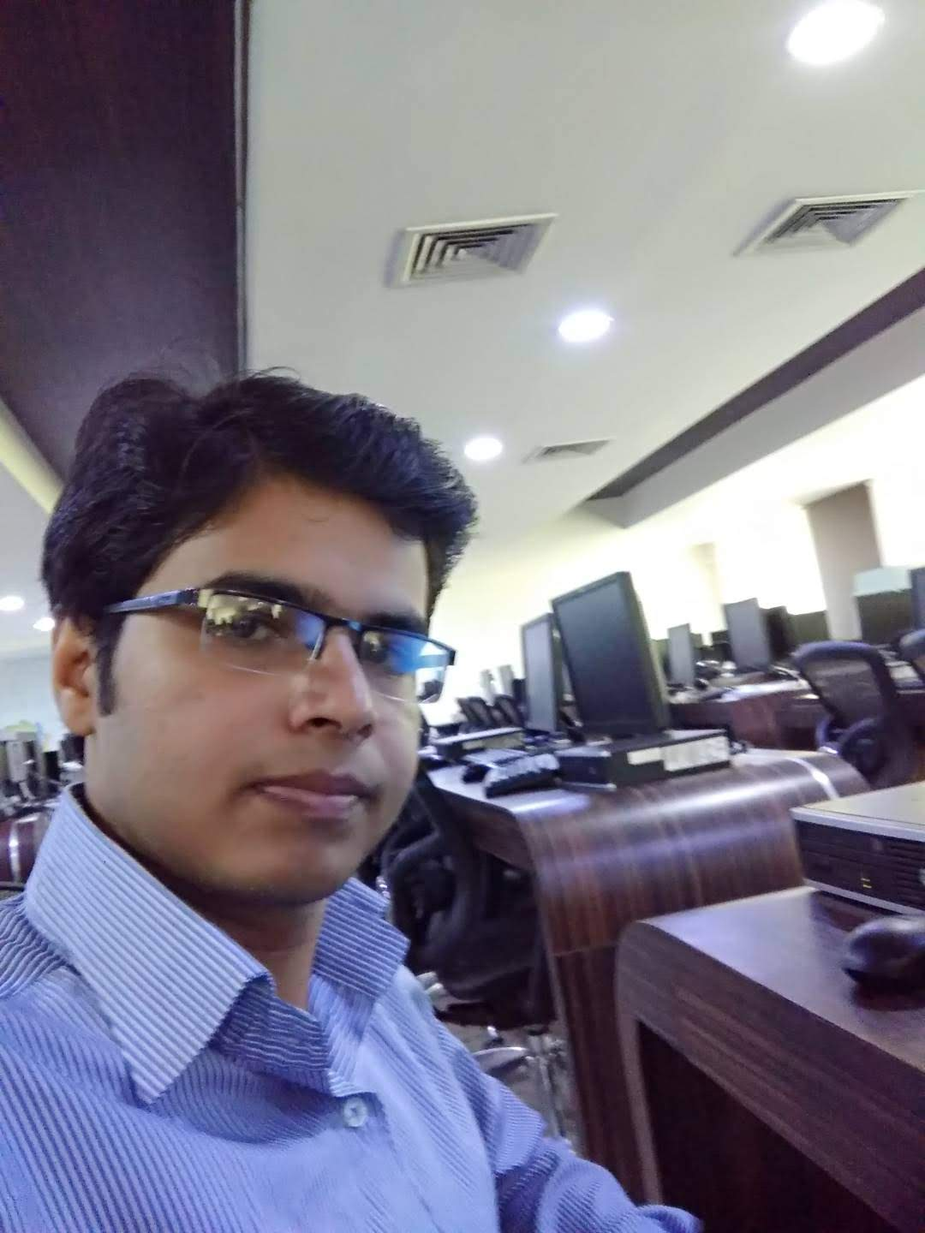
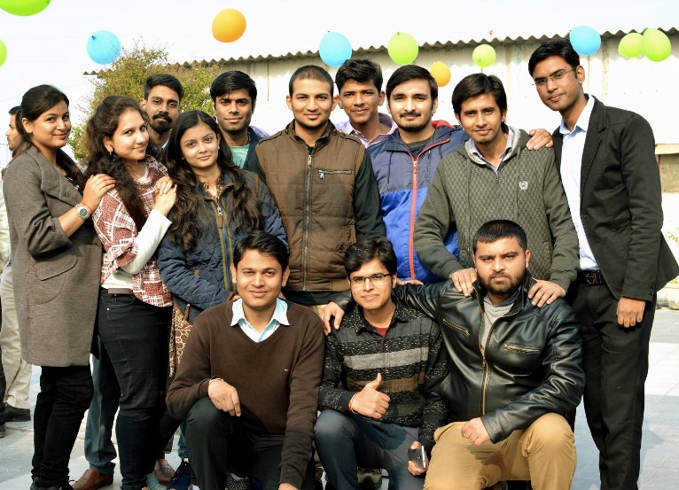
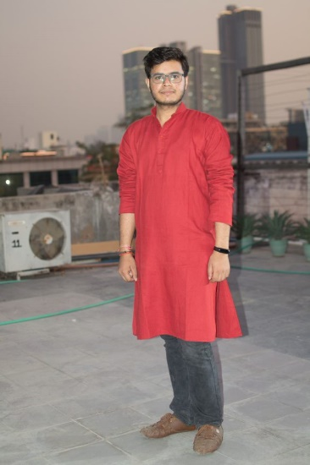
YEAR 2016
YEAR 2017
My Experience with Omnie…
SINCE March 2016
YEAR 2020

