Slide 1
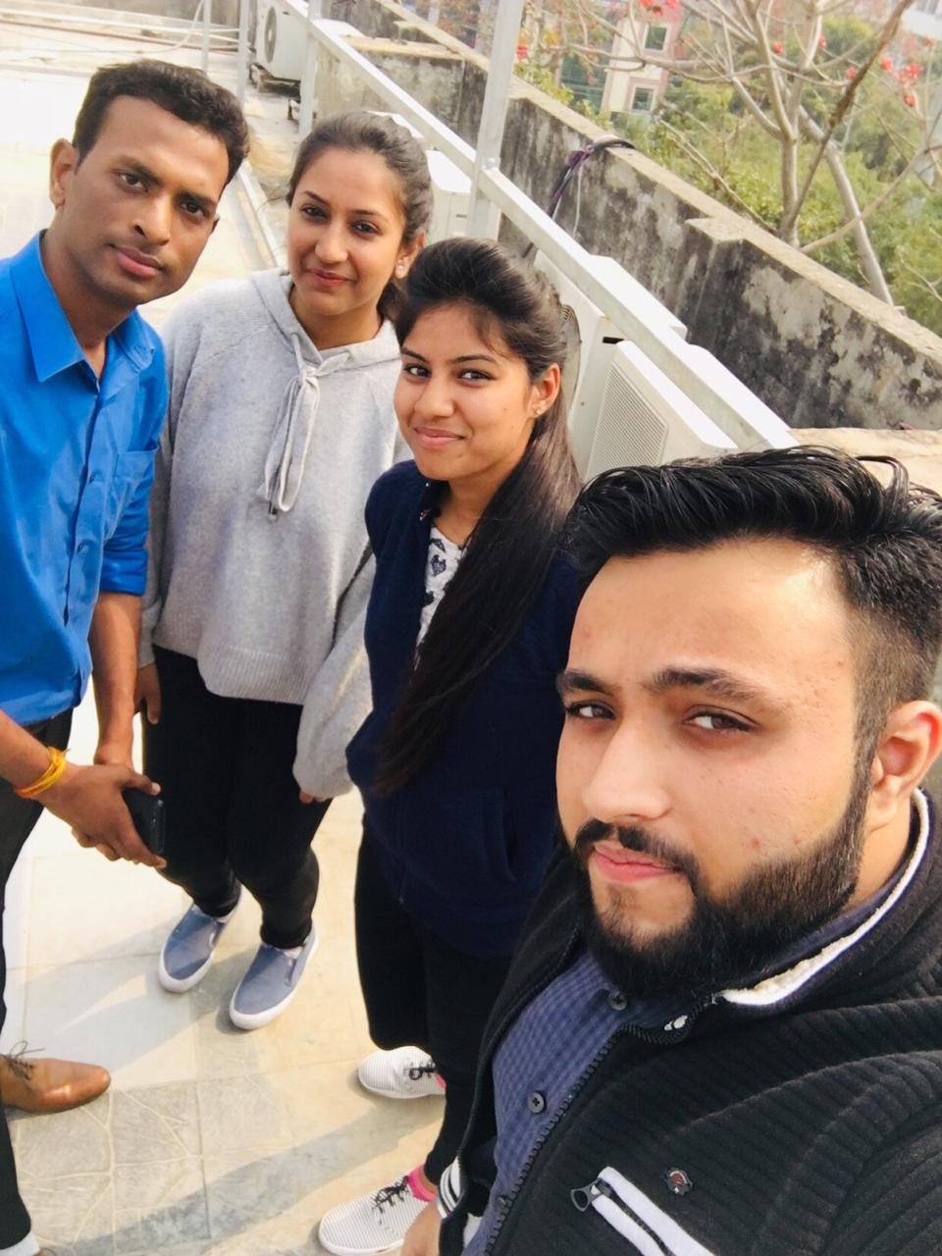
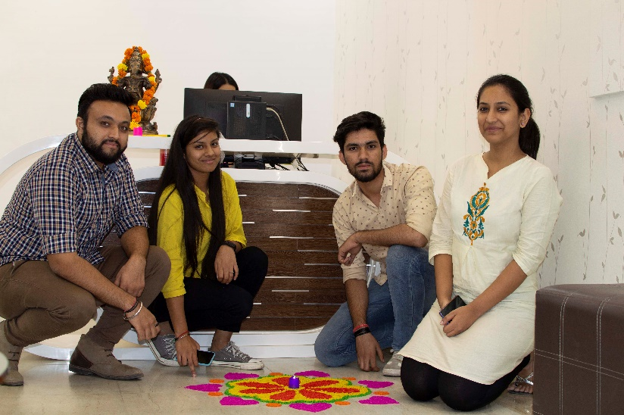
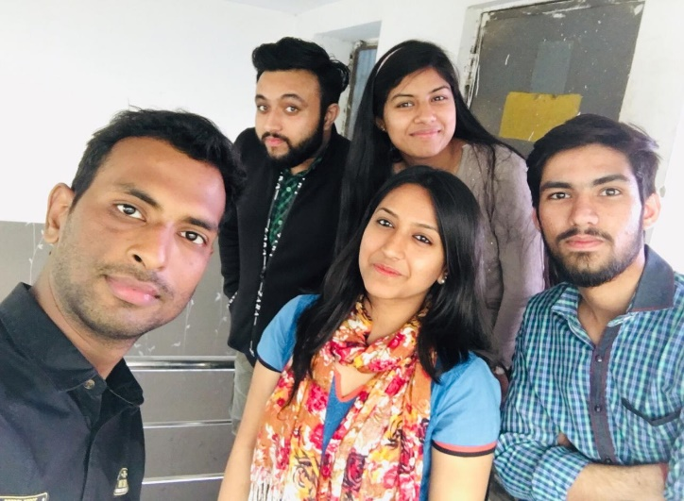
YEAR 2019 (year of your joining)
YEAR 2019 (Any special picture of you – at your workplace)
My Experience with Omnie…
SINCE JAN 2019 (Since your Year of joining)
When I started my journey here I was skeptical about how it would all go, how company environment will be and many such thoughts which used to haunt me. But the on my first day itself I got this vibe that everything will be great. That is omnie's vibe. Omnie welcomes you with open heart. Yes there is discipline which is essential but also this environment where I could be myself is a very rare thing I believe. Making every day special. ❤
YEAR 2020

