Slide 1
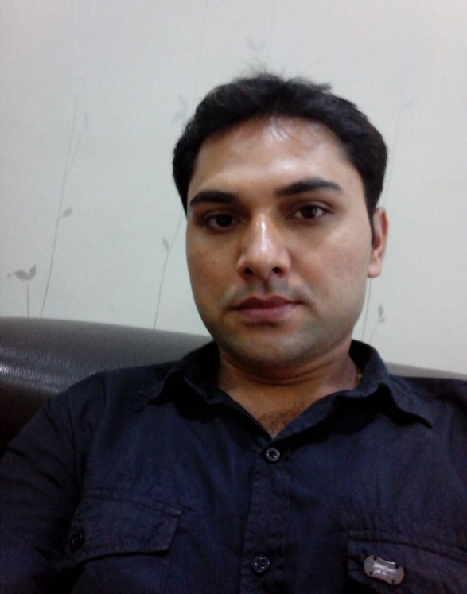
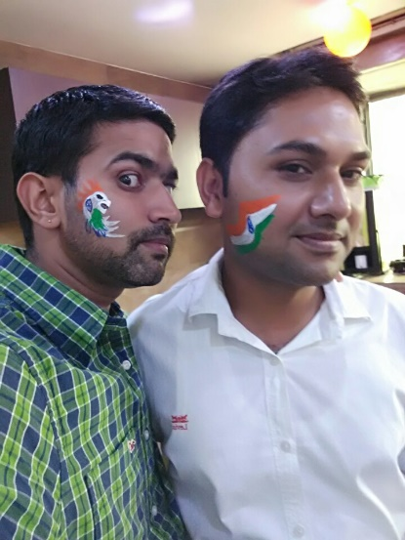
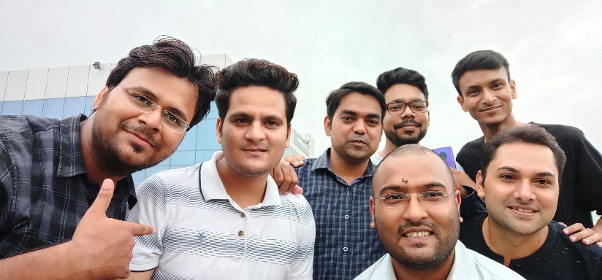
YEAR 2013
YEAR 2017 (Independence Day Celebration)
My Experience with Omnie…
SINCE September 2013
From last 6 years I am part of Omnie family, where I get good team leaders, team and friends. In this family, no one restricted to enhance their knowledge and every time you got the support of seniors and team members in every aspect of your life.
YEAR 2020

