Slide 1
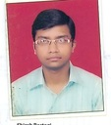
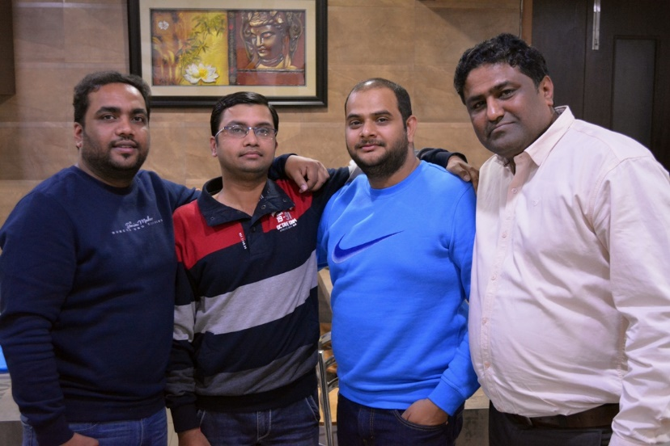
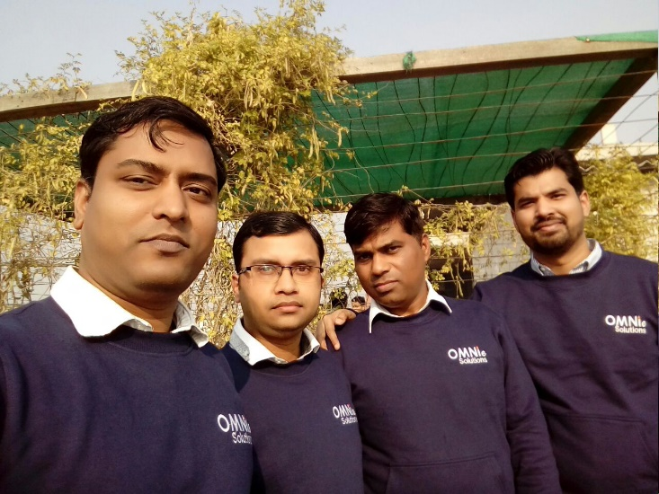
YEAR 2009 (year of your joining)
YEAR 2018 (Any special picture of you – at your workplace)
My Experience with Omnie…
SINCE MAY 2009 (Since your Year of joining)
"I have gained skills and experience that I never imagined."
The work environment of the company is very good. I feel proud to be part of the company and good opportunity to showcase talent.
YEAR 2020

