Slide 1
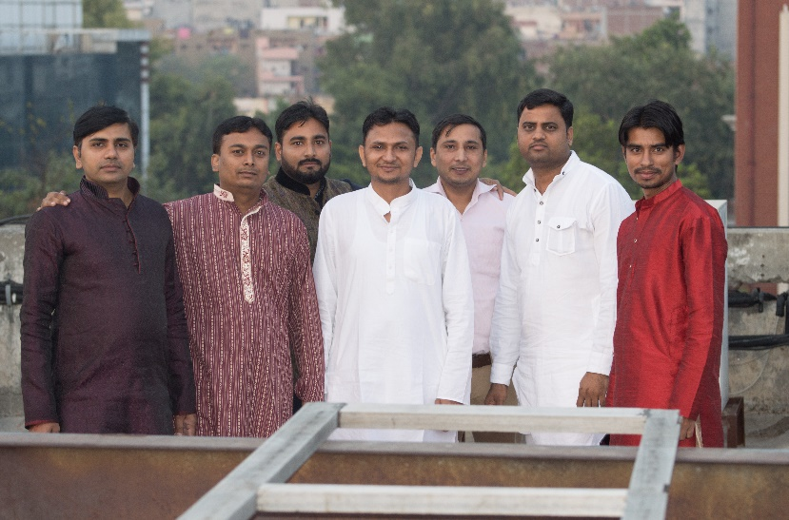
YEAR 2018
YEAR 2019
My Experience with Omnie…
SINCE NOV 2018
Great work-life balance. Excellent people to work with. Leadership's push for continuous improvement of processes, metrics, bonuses, and new benefits is great.
YEAR 2020

