Slide 1
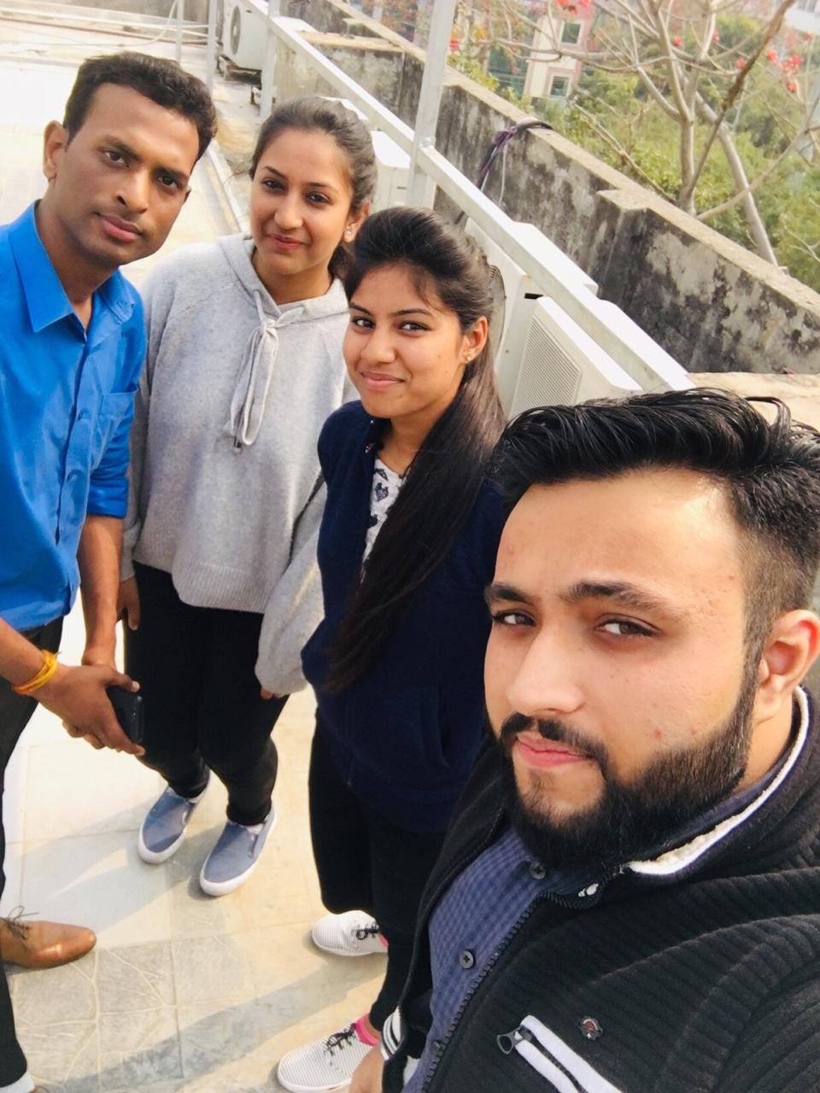
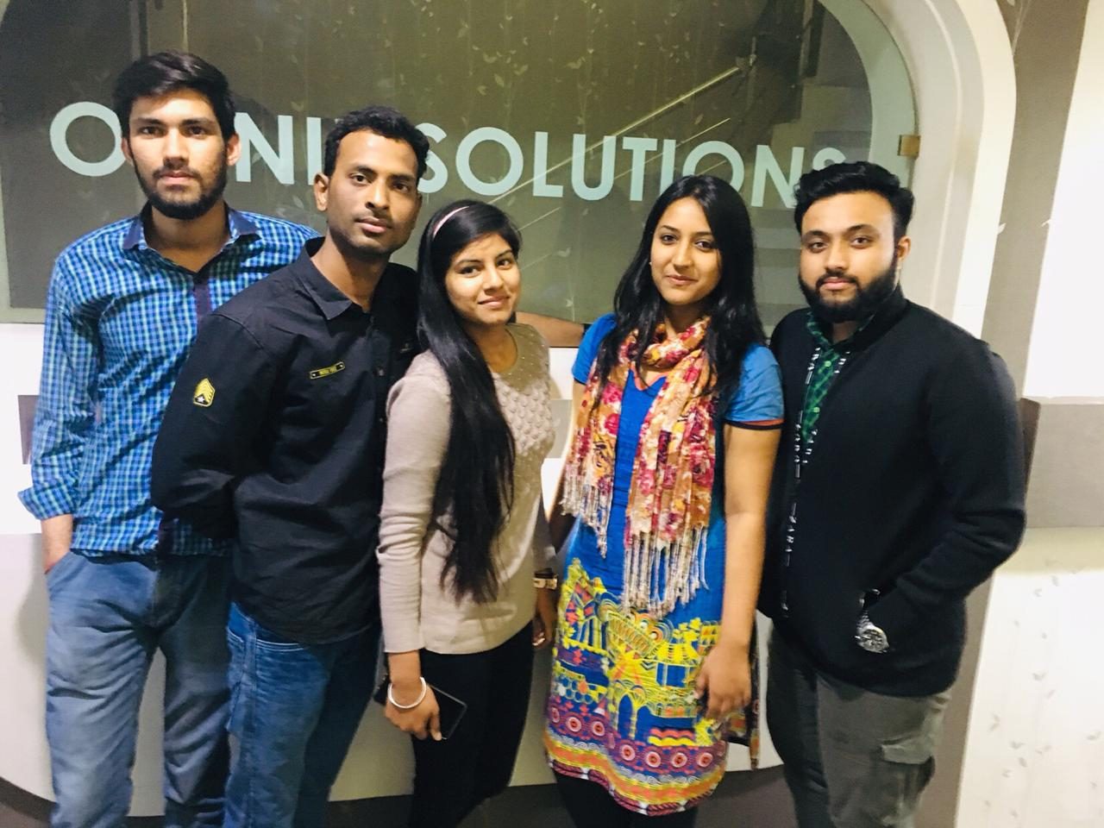
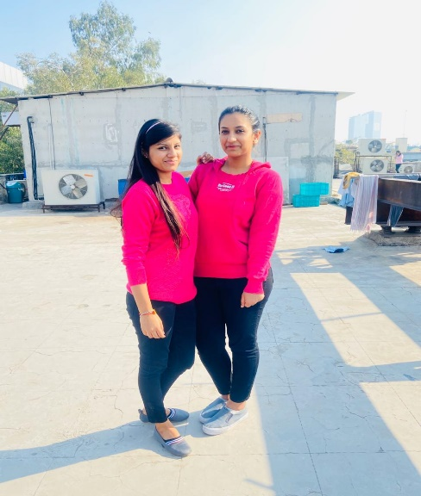
YEAR 2019(year of your joining) YEAR 2019
YEAR 2018 (Any special picture of you – at your workplace)
4th March 2019
My Experience with Omnie…
SINCE JAN 2019(Since your Year of joining)
I have been working at OMNIe since 10 months…OMNIe is the the best place to learn and grow. Professional environment, flexible timings., and a nice workplace for fresher's …
YEAR 2020

