Slide 1
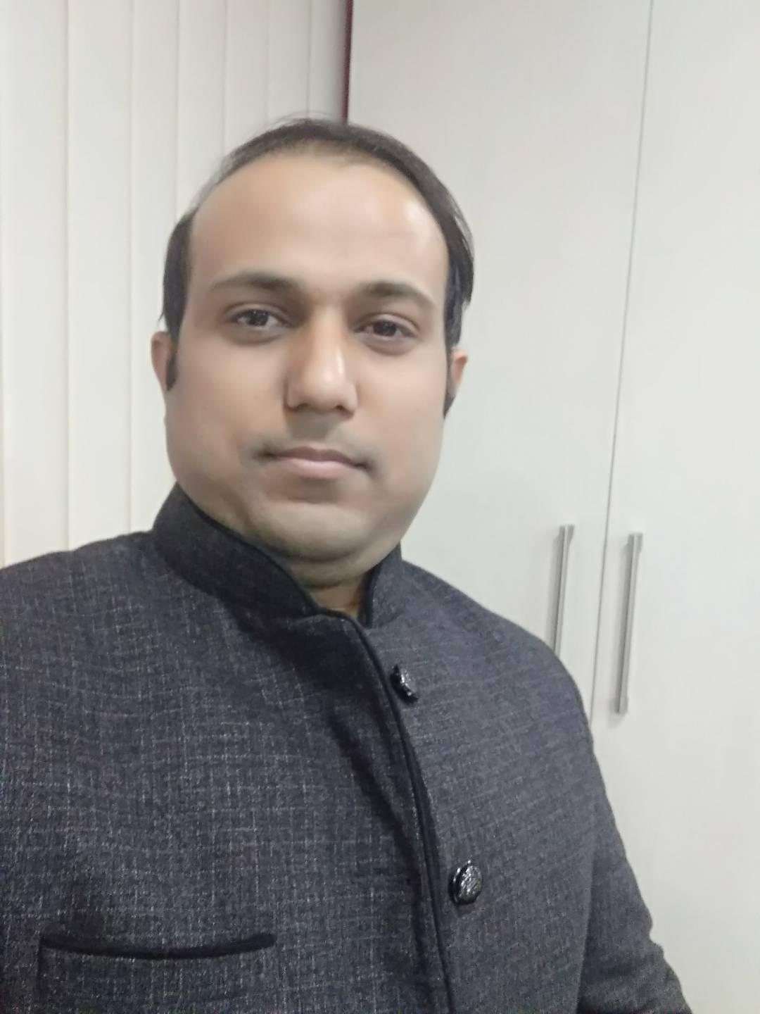
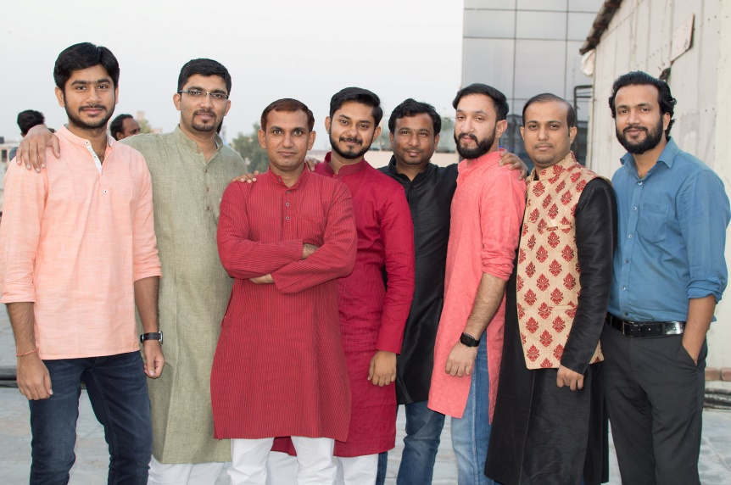
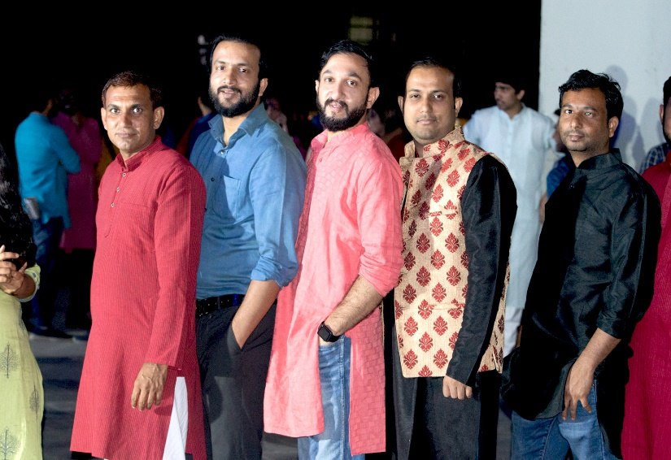
YEAR 2019
YEAR 2019
My Experience with Omnie…
SINCE MAR 2019
Life bahut choti hai dosto, so go on beyond your imagination and innovation and never regret anything to do that made you smile.
YEAR 2020

