Slide 1
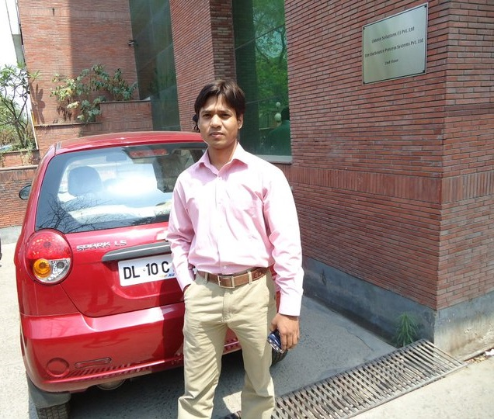
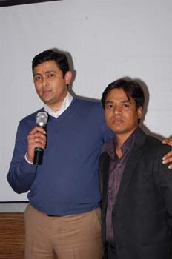
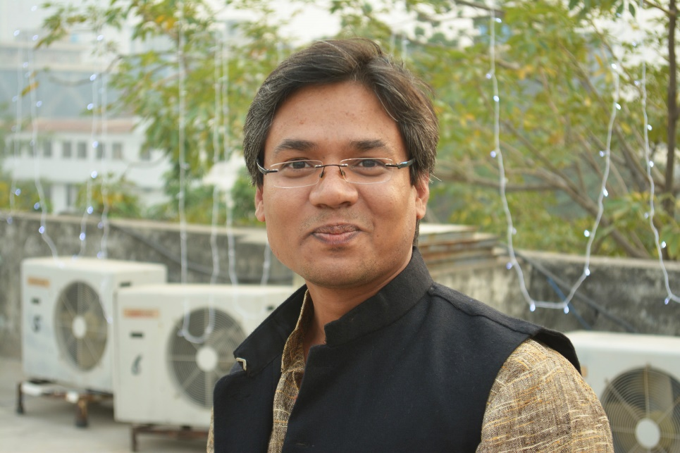
YEAR 2010
YEAR 2012
YEAR 2018
My Experience with Omnie…
SINCE JAN 2010
For me, Omnie is a family. Everyone thinks, plans and does best for their family, similarly, i think, plan, and try to do best for my company. This feeling was not in the beginning but that feeling came over the time automatically. My best wishes to the company. Cheers!
YEAR 2020

