Slide 1
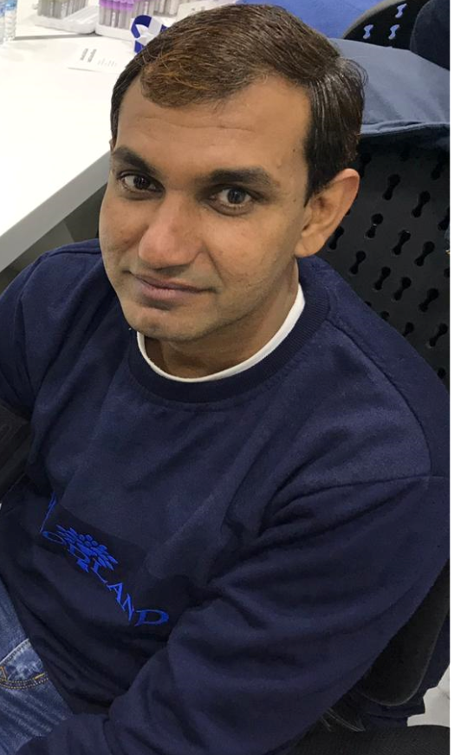
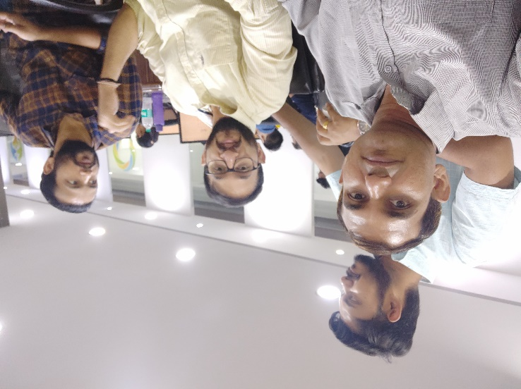
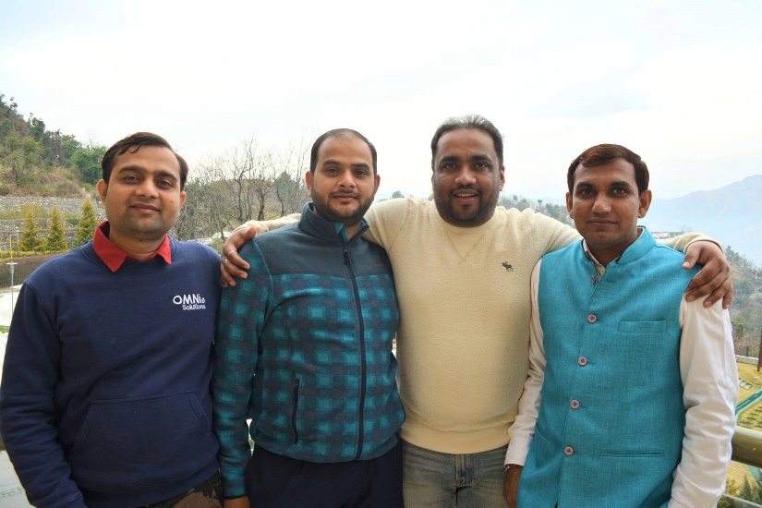
YEAR 2017
YEAR 2018
My Experience with Omnie…
SINCE FAB 2017
Since year 2017 I am part of Omnie family, where I got good work, team members and support from lead(s). Here in Omnie I got many chance to enhance my knowledge, team handling skills and customer interaction. Last few years Omnie bring many new policies in employee benefit. Which feel me good about Omnie.
YEAR 2019

