Slide 1
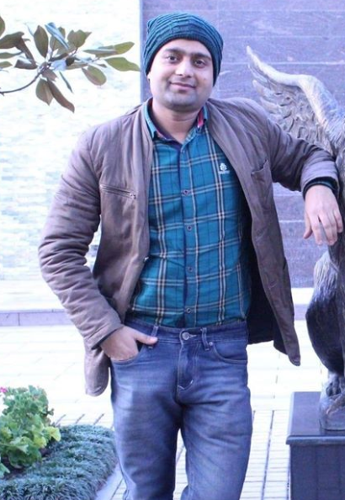
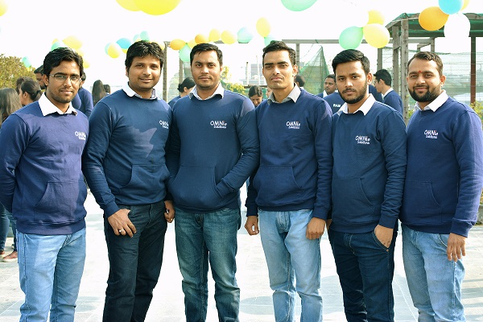
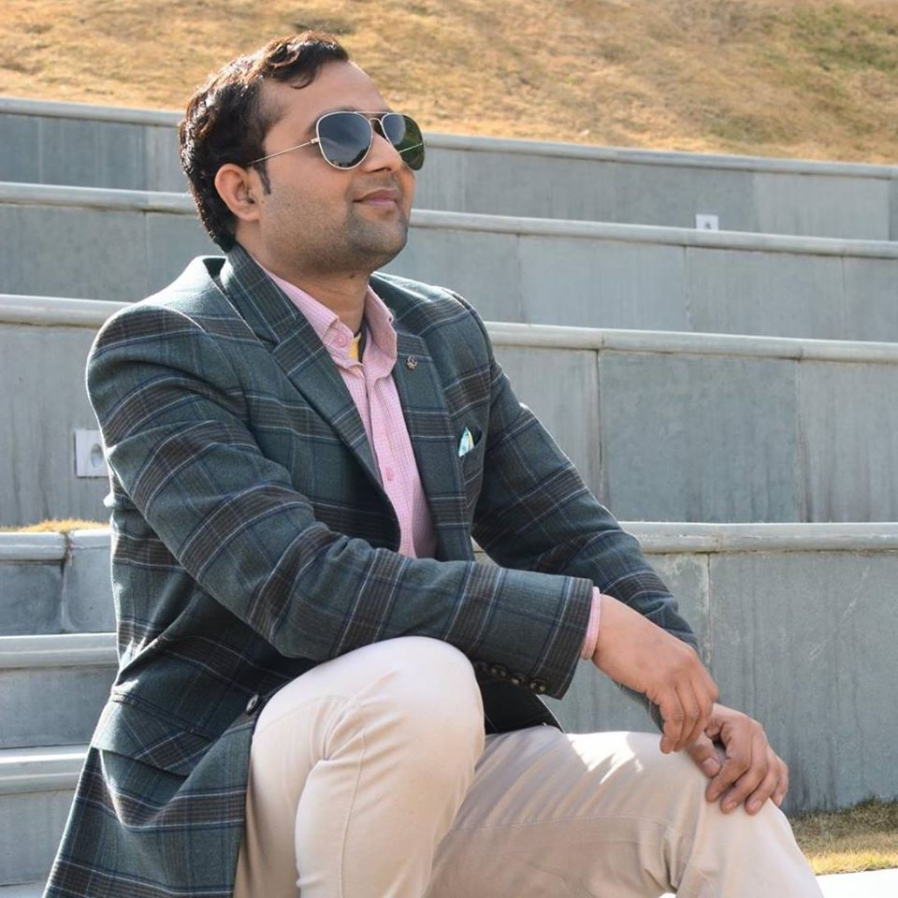
YEAR 2016 (year of your joining)
YEAR 2018 (Any special picture of you – at your workplace)
My Experience with Omnie…
SINCE AUG 2016 (Since your Year of joining)
I am working since 2016, I got good projects and team. I enjoy good food from Omnie kitchen. Thanks to Omnie to provide me good work environment .
YEAR 2020

