Slide 1
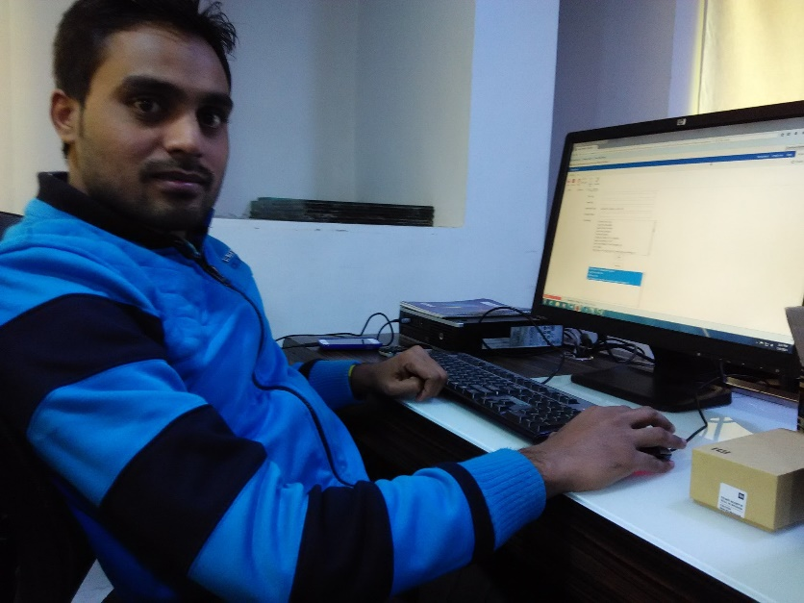
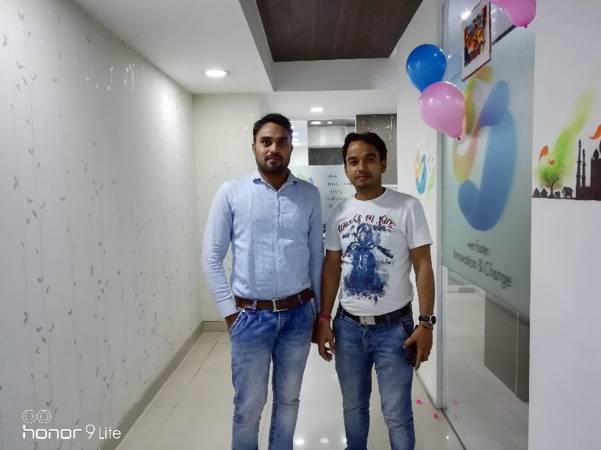
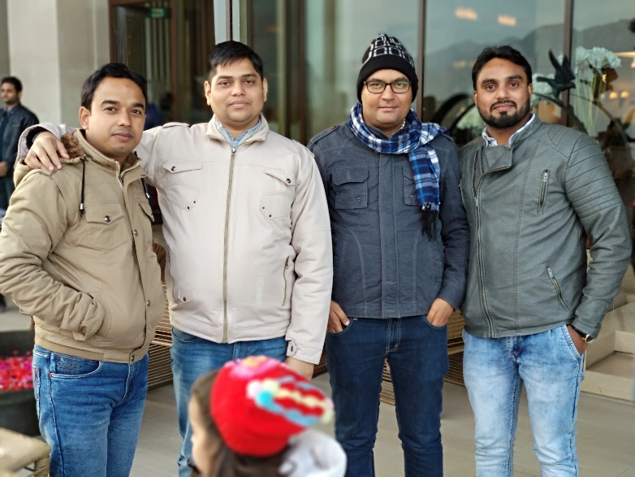
YEAR 2014
YEAR 2018
My Experience with Omnie…
SINCE Nov 2014
Being an employee of Omnie Solutions since last 5 years, I have had all kind of experiences and opportunity to work vividly and scope of required growth are the points that I appreciate the most.
YEAR 2019

