Slide 1
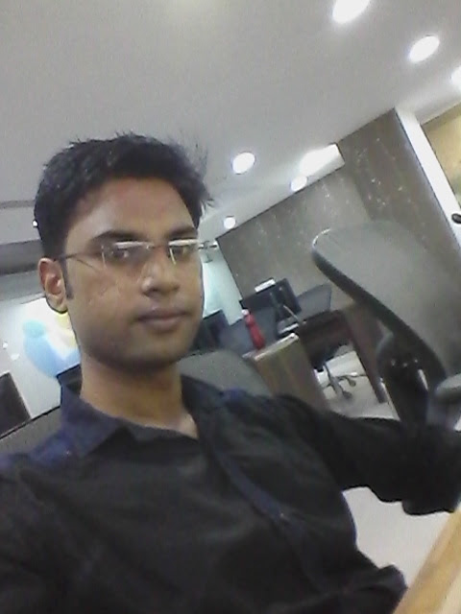
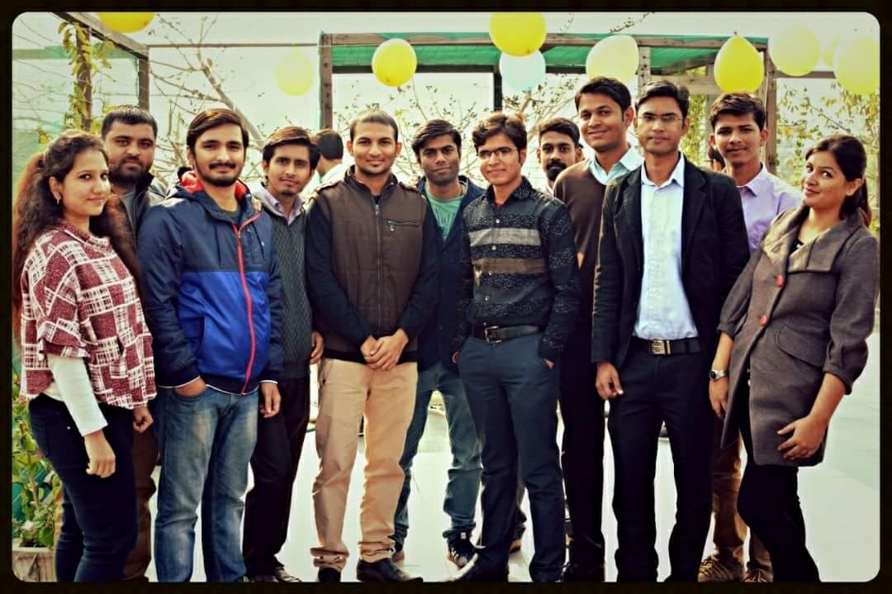
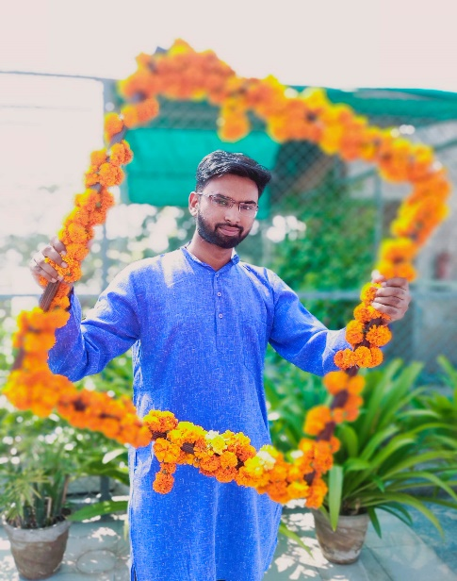
YEAR 2016
YEAR 2018
My Experience with Omnie…
SINCE JAN 2016
After working for a span of 4 years with Omnie Solutions. It was wonderful time working here filled with great memories to cherish. I have learnt a lot from here as personal growth as well as professional growth.
YEAR 2019

