Slide 1
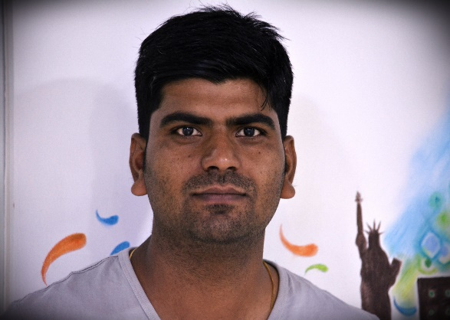
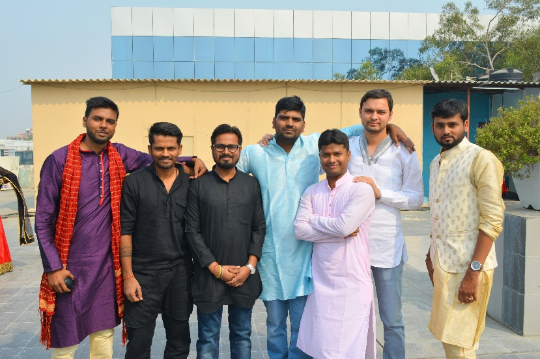
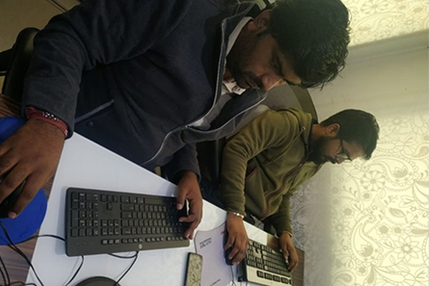
YEAR 2015 (year of your joining)
YEAR 2018 (Any special picture of you – at your workplace)
My Experience with Omnie…
SINCE JAN 2015 (Since your Year of joining)
I love the phrase ” Don’t Count the Days Make the Days Count ” and the creating of happiness culture in the workplace should become a great adventure for all who is in pursuit of happiness.
I constantly find here a new ways to better encourage, lead, and motivate the team.
YEAR 2020

