Slide 1
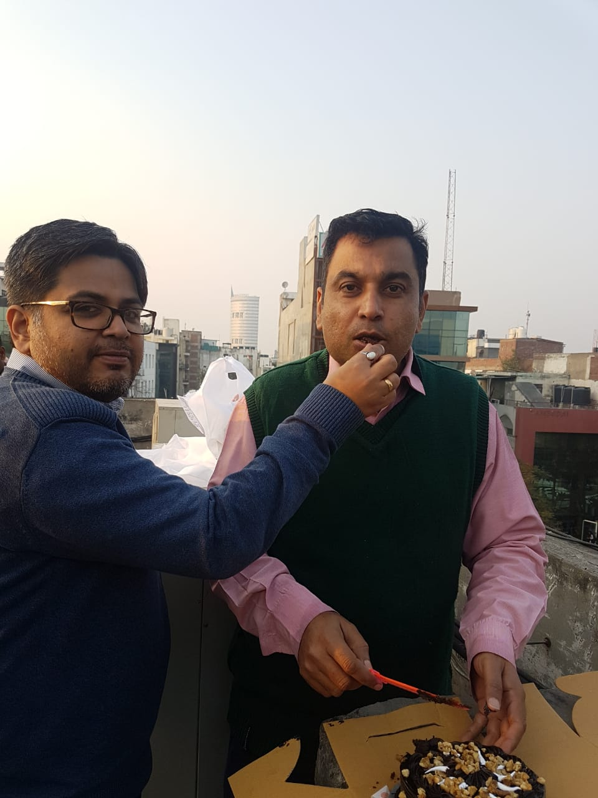
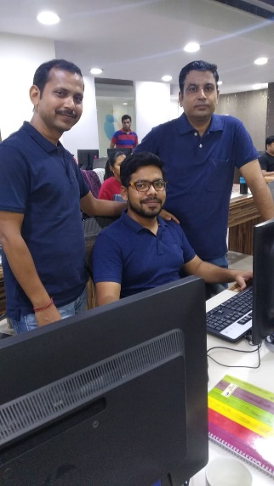
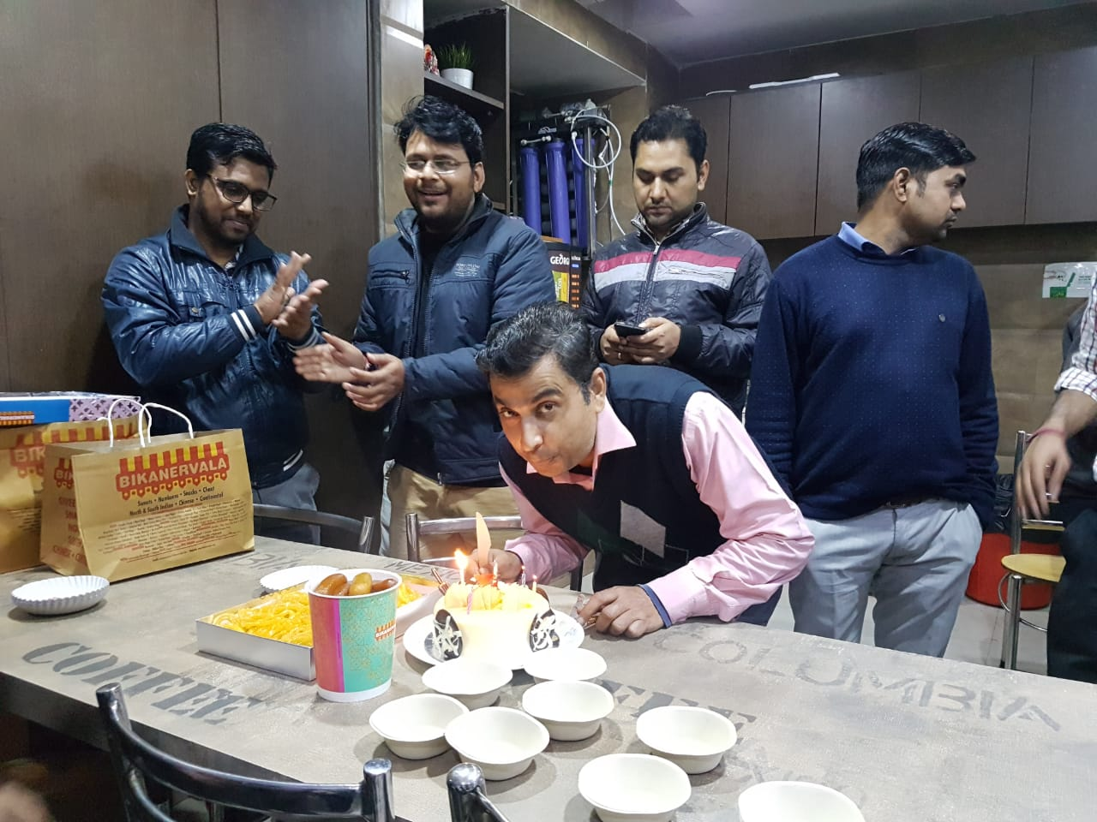
YEAR 2016 (year of your joining)
YEAR 2019 (Any special picture of you – at your workplace)
My Experience with Omnie…
SINCE NOV 2016 (Since your Year of joining)
Excellent , more than Expectations, Supportive & flexible Working Environment , Good Team Work , Friendly Hr Policies, we feel like great Indian family , I can say – “Saare Jhaan Se Acchi OMNIE Hamari”
YEAR 2020

