Slide 1
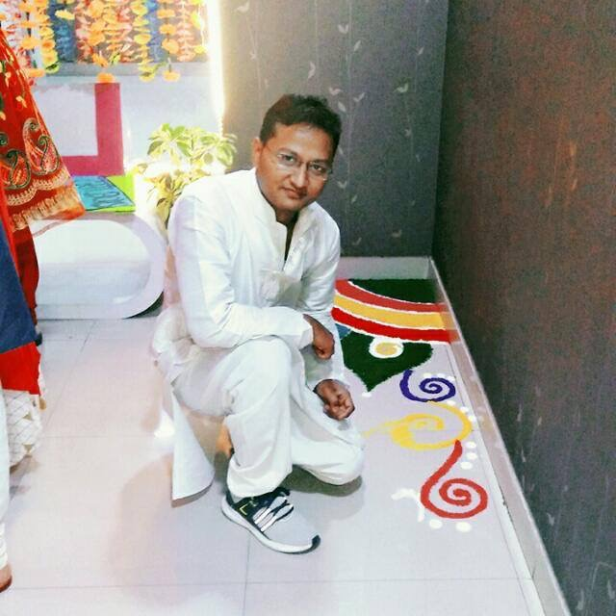
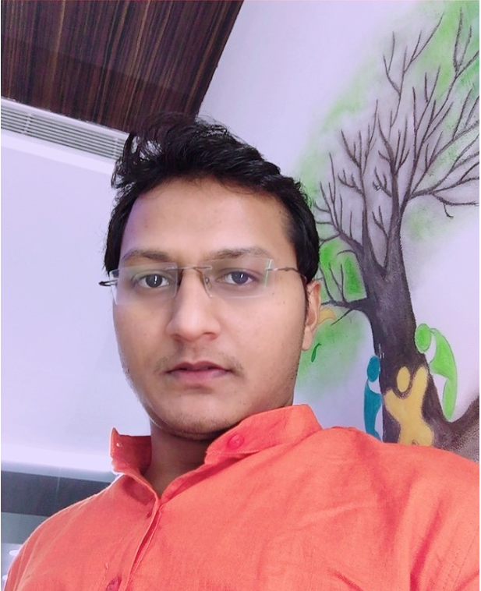
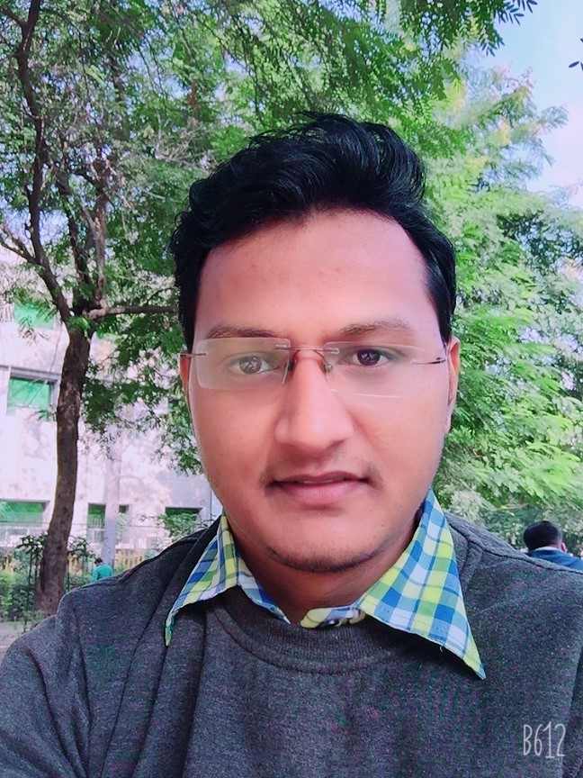
YEAR 2017 Joing Year
Year 2018
My Experience with Omnie…
SINCE JOINING 3 JAN 2017
I joined Omnie family as a trainee in 2016 and got chance to work with Omnie family as an associate software developer. our first workspace celebrations occurred on Jan-2017, This special day we all knew as Omnie anniversary, after this. I got many chance to enjoy with Omnie family. My experience with Omnie are awesome. Some Special: working environment are very Good. I learn many things by Omnie, and our team member.
YEAR 2020

