Slide 1
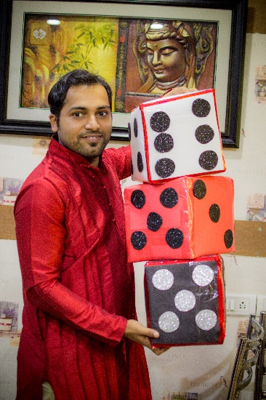
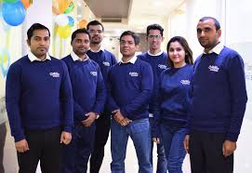
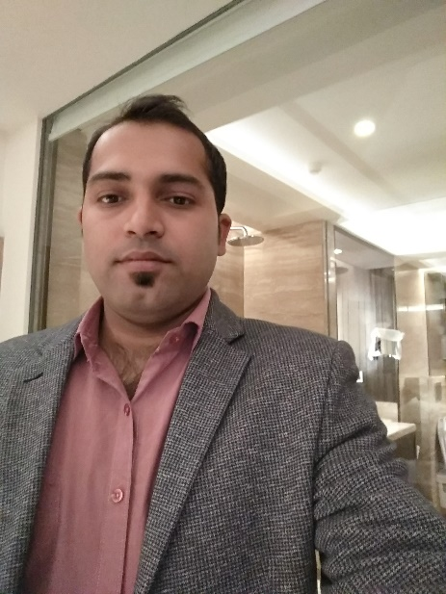
Year 2016
YEAR 2018 (Special Picture with Team)
My Experience with Omnie…
SINCE April 2016
I experienced and achieved many things in terms of personal and professional like Disciplined life, positive attitude, build stamina to work long hours, positive utilization of time and handle any stiff timeline. The work environment of the company is very good. I feel proud to be part of the Omnie Family and a good opportunity to showcase talent. The secret of Success is workplace & cultures, which include open lines of communication, a clear organizational mission, work-life flexibility, and competitive pay and benefits. And not to forget, the fun that all I believed in the Omnie. .
YEAR 2020

