Slide 1
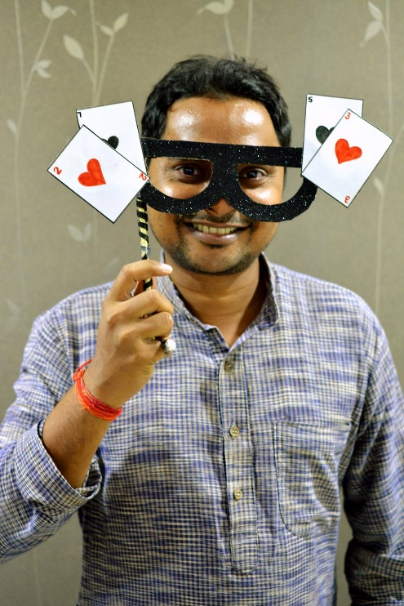
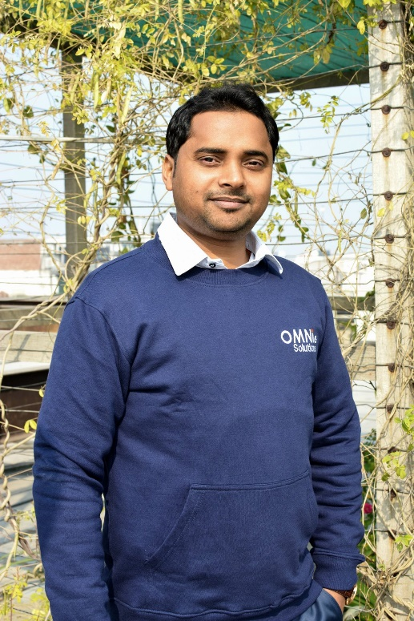
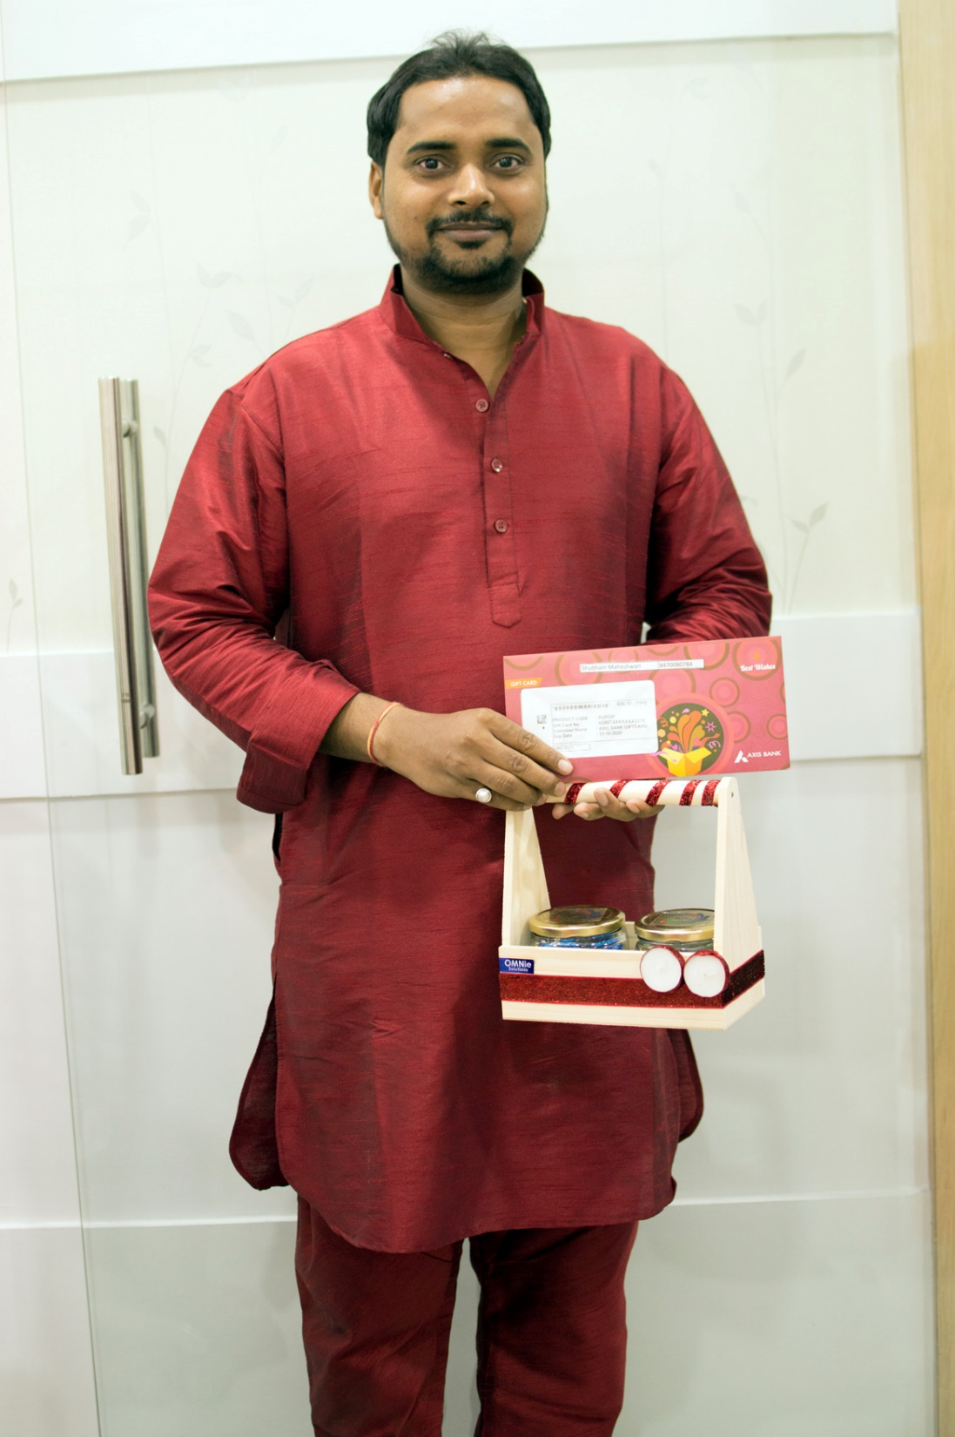
YEAR 2017 (Joining)
YEAR 2018 (Celebrating 16th an anniversary)
My Experience with Omnie…
SINCE Aug, 2017
"Omnie Solutions is a company, where I am continue learning Good habits, positive thinking and passion to grow my personal and professional etiquette. A well-disciplined environment, good healthy organic food, and helpful staff that belongs to a good company. Happy to be with OMNIE SOLUTIONS." - Shubham Maheshwari
YEAR 2020

