Slide 1
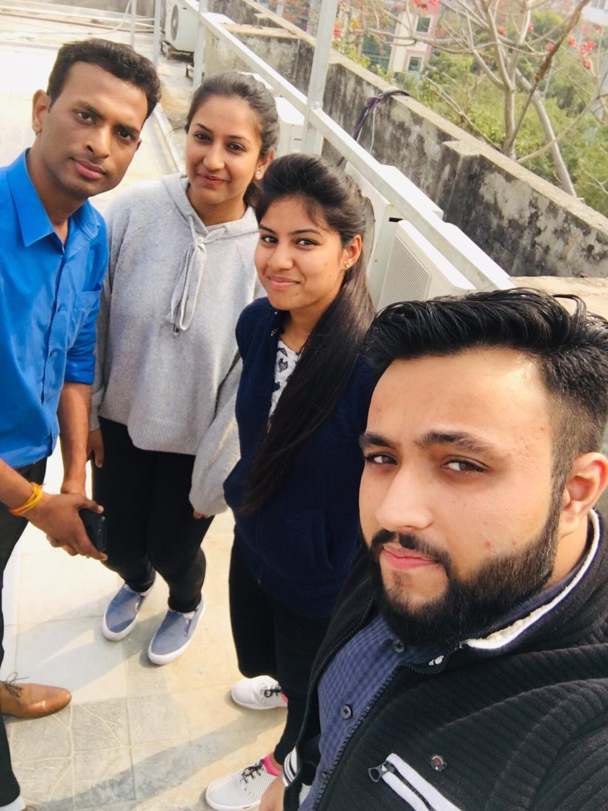
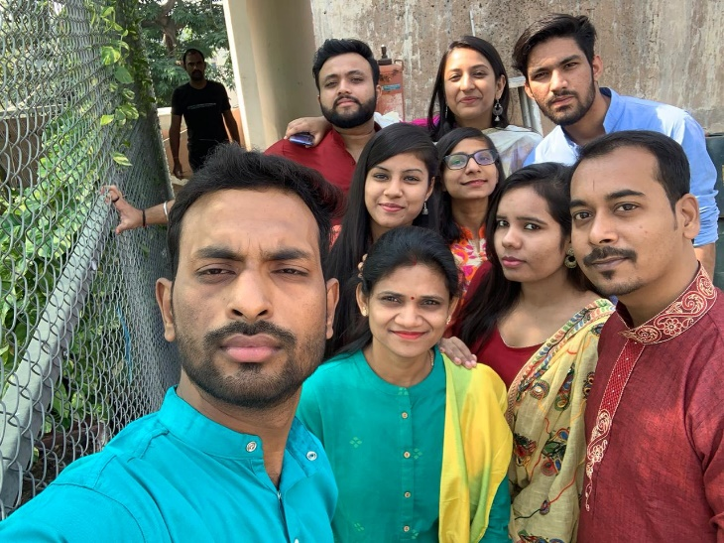
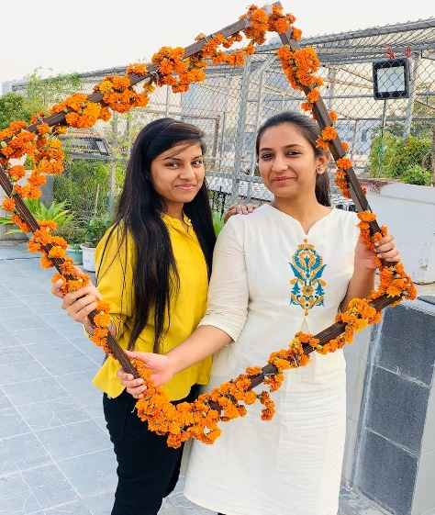
YEAR 2019 (year of your joining)
YEAR 2019 (Any special picture of you – at your workplace)
My Experience with Omnie…
As you can make out from my smile in each picture how essited I am. I always imagined working in an organization which has all the right elements for a happening company and I think I have landed in the right place. I have not only found a good exposure for working but also people I will cherish being with for life. Although it only has been 7 months in Omnie but I already feel the warmth. <3 .
SINCE JAN 2019 (Since your Year of joining)
YEAR 2020

