Slide 1
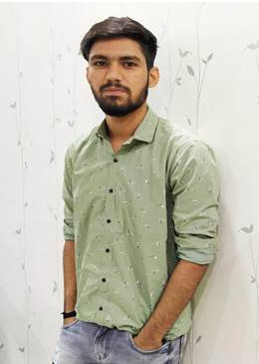
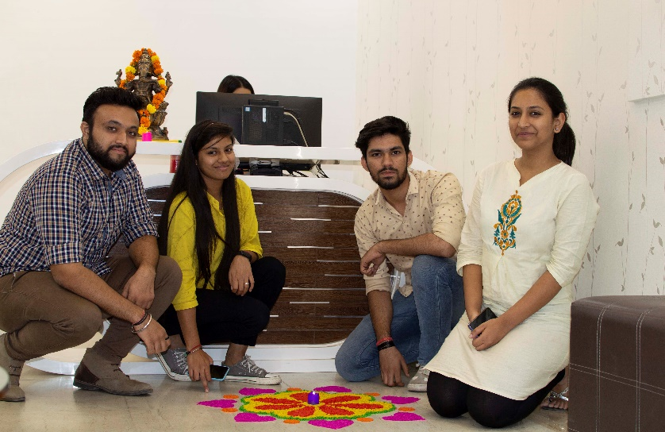
YEAR 2019
YEAR 2019
My Experience with Omnie…
SINCE JUN 2019
I learned a lot since I joined Omnie about various technology. Omnie offers a stable platform to work on several projects that helps me enhance my efficiency. Despite this, I made a lot of friends that I cherish and get to enjoy with.
YEAR 2020

