Slide 1
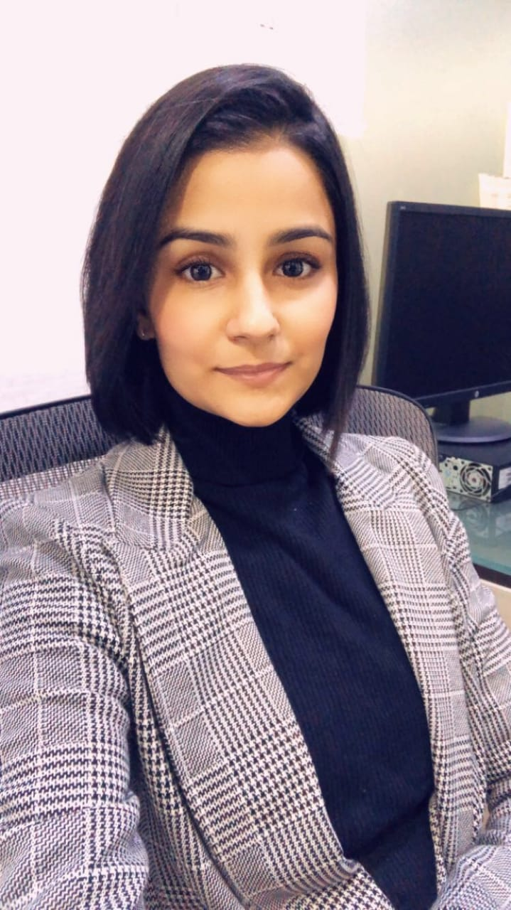
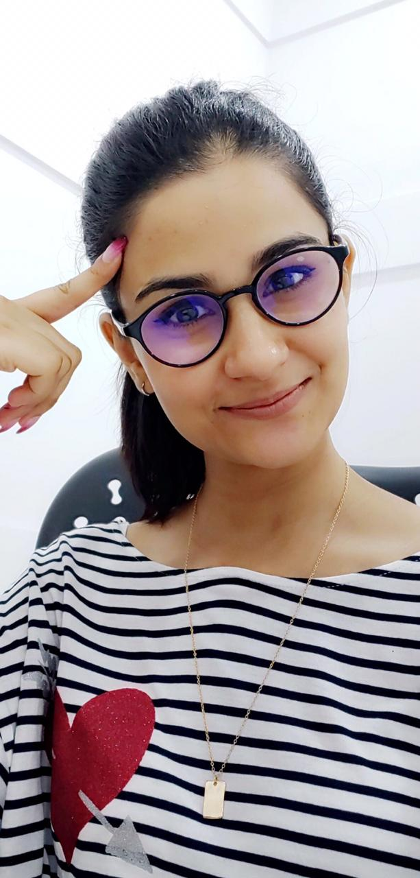
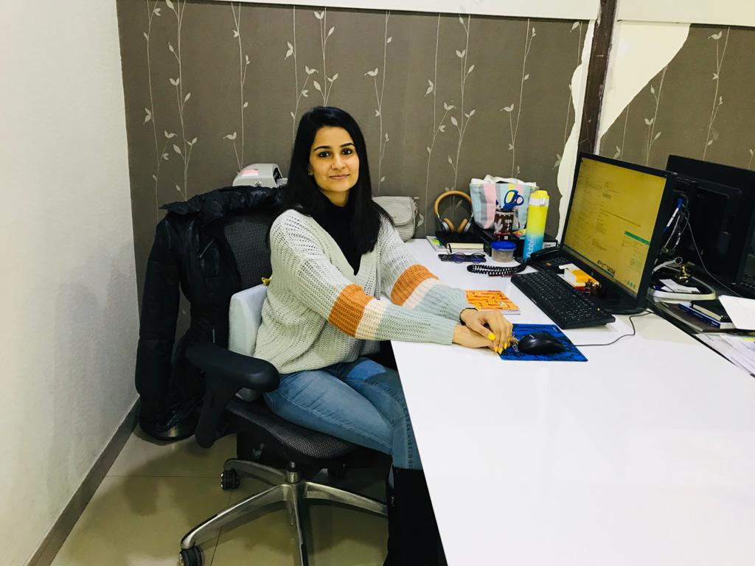
YEAR 2018
YEAR 2019(MID)
My Experience with Omnie…
SINCE DEC 2018
My professional life started since I became a part of Omnie Family.
I have received so much respect and love. I like being known as a “Cool HR” and wish to see myself grow with bigger responsibilities and help others grow with me.
YEAR 2020

