Slide 1
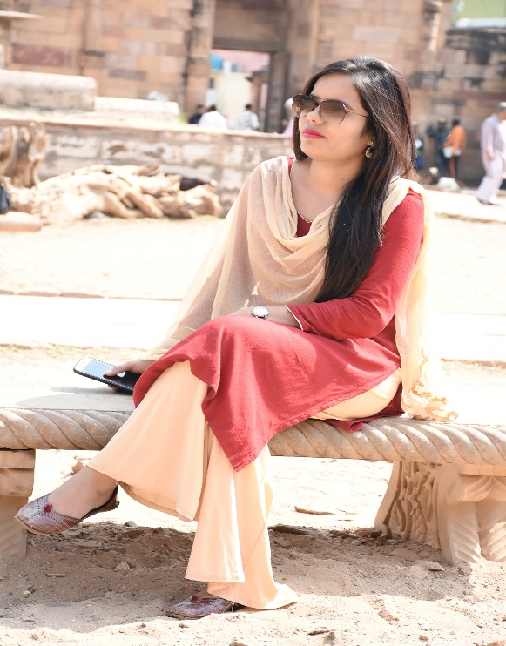
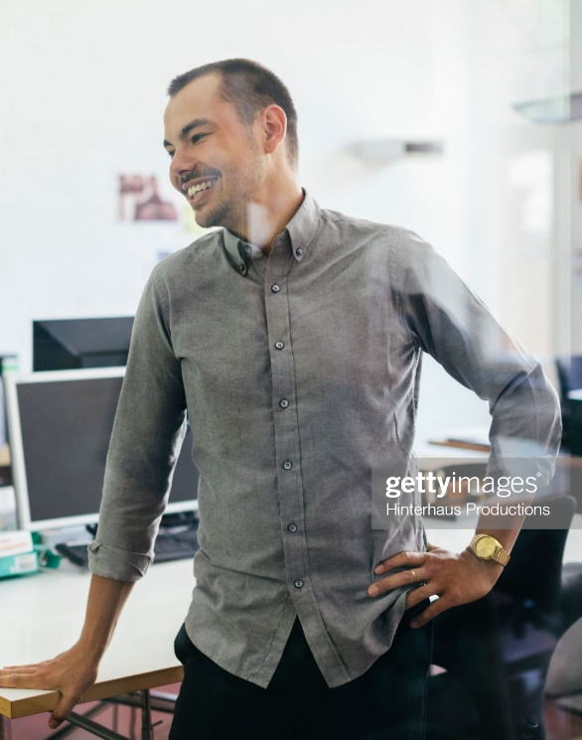
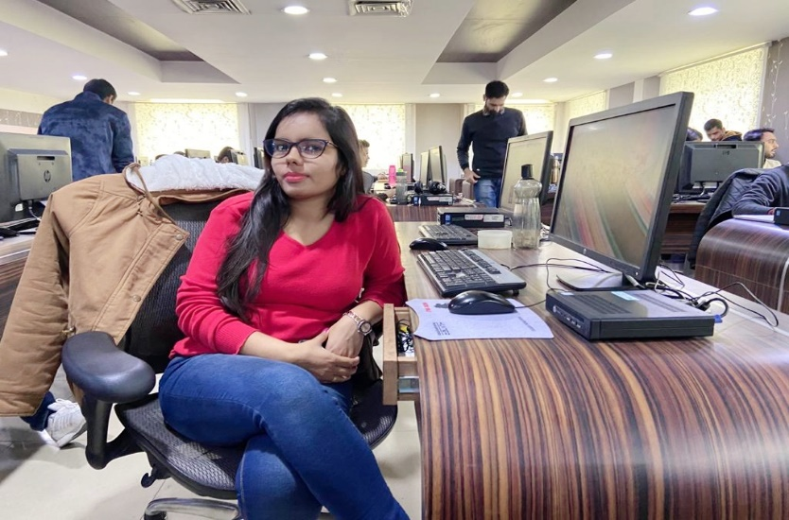
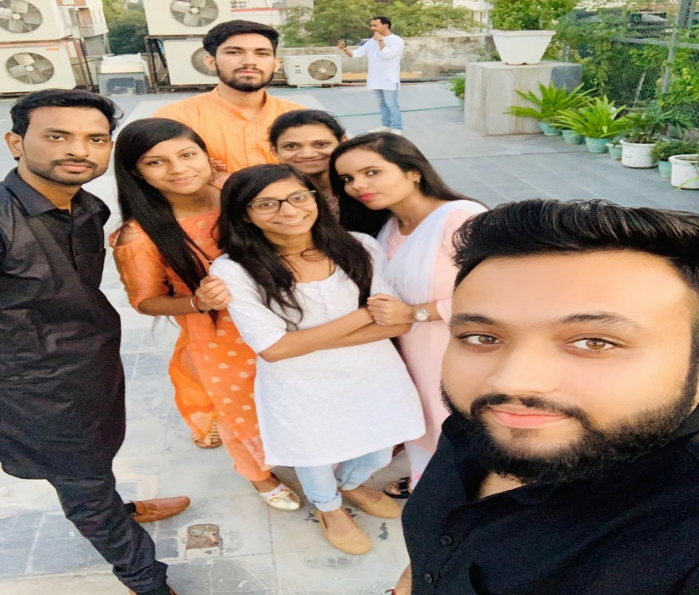
YEAR 2019
YEAR 2019
My Experience with Omnie…
SINCE JUNE 2019
Being a career oriented girl, OMNIE SOLUTIONS gave me an opportunity to wok as a fresher after 3.5 years gap. It is like a dream comes true. My journey is very good till now as I am learning a lot under the guidance of very experience person. I am looking forward to establish my career in a right and positive way.
YEAR 2020

