Slide 1
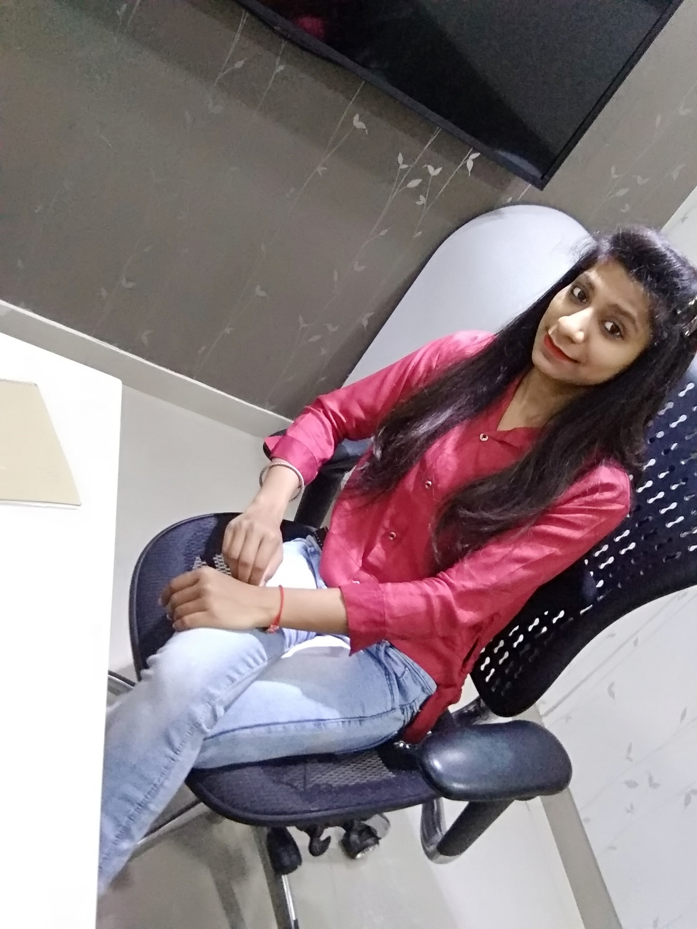
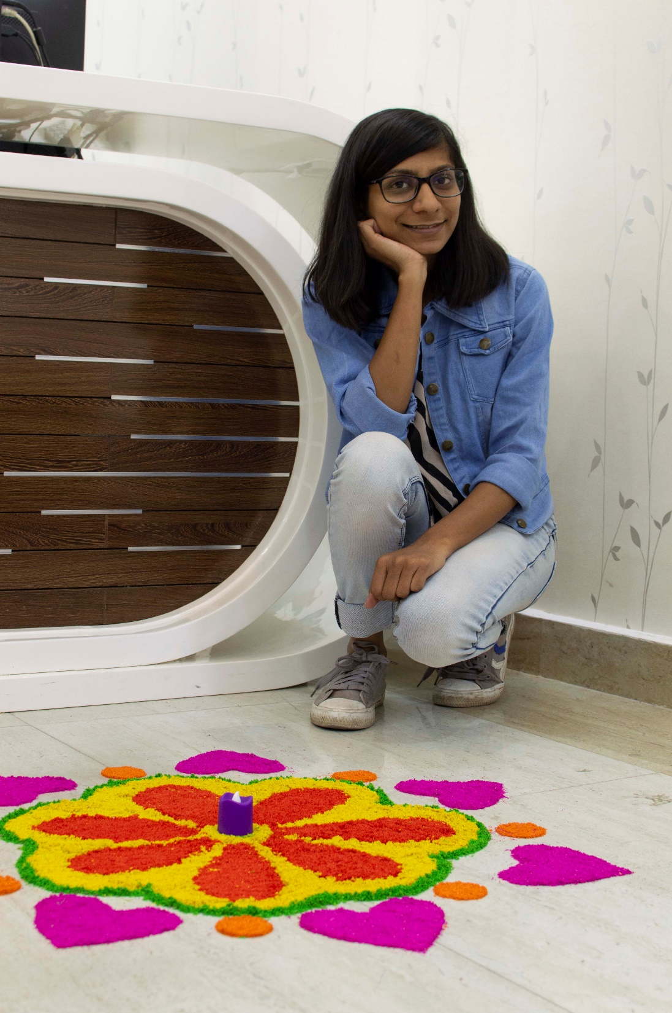
YEAR 2019 (On Rangoli)
YEAR 2019 (year of your joining)
My Experience with Omnie…
SINCE JUN 2019 (Since your Year of joining)
As Omnie is my first company, My experience with Omnie is great so far. Colleagues are very supportive. I have gained skills and confidence that I never imagined. (put your feelings towards Omnie in words )
YEAR 2020

