Slide 1
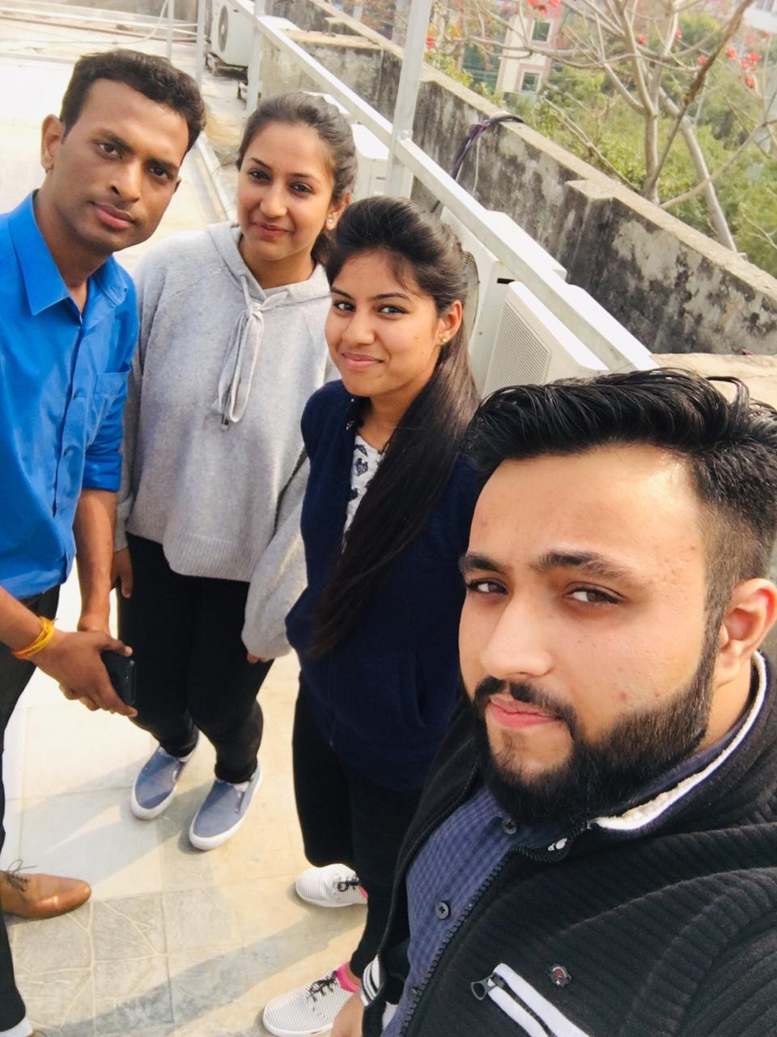
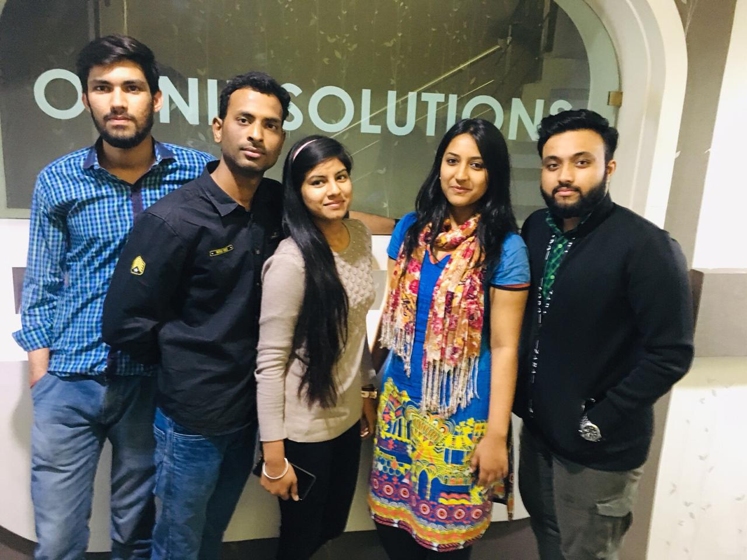
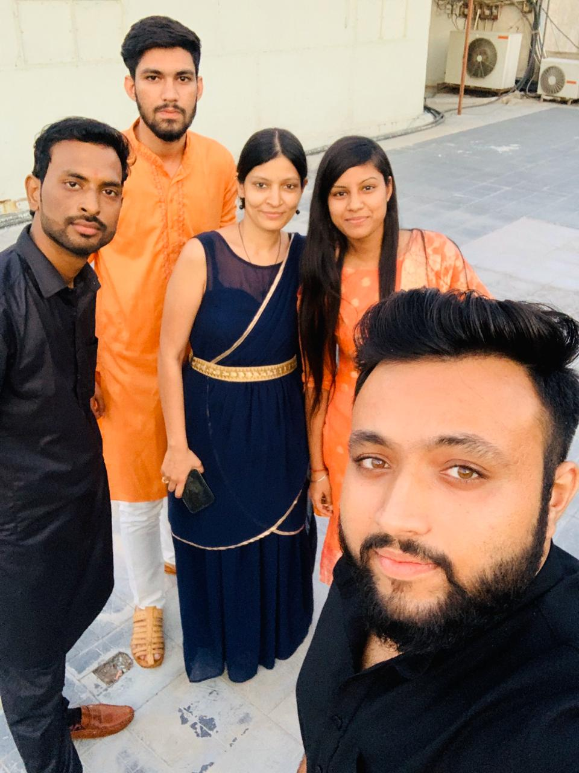
4th March 2019
At workplace
YEAR 2019
My Experience with Omnie…
Festival
SINCE March 2019
My goodness, the people around me have all kinds of ideas for how you can they get better. Being a great teammate is hard work. It requires intention and discipline as well as our team and workplace as Omnie. Learning environment , smart peoples, Clean environment and motivational surroundings.

