Slide 1
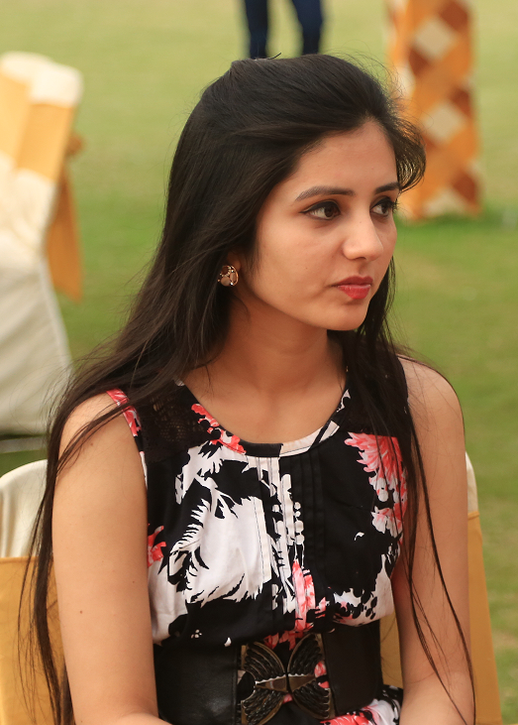
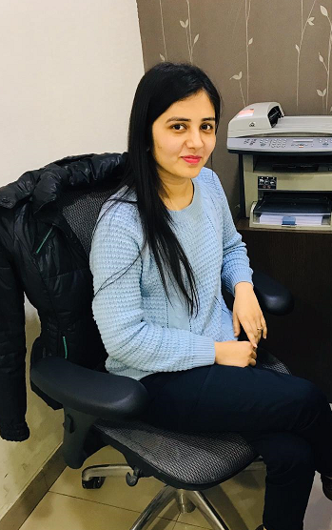
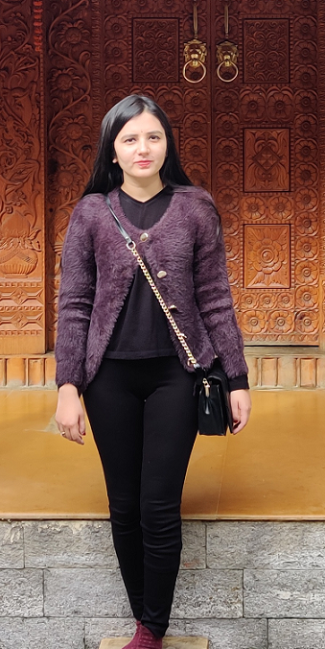
YEAR 2015
YEAR 2019
My Experience with Omnie…
SINCE JAN 2015
In order to reach at your success level, it starts from the first step and I took my first step of career with Omnie Family where I am learning so many things to become better day by day and I am grateful for this opportunity at Omnie.
I wish Omnie many more years of Success, Prosperity and happiness.☺
YEAR 2020

